Slide 1
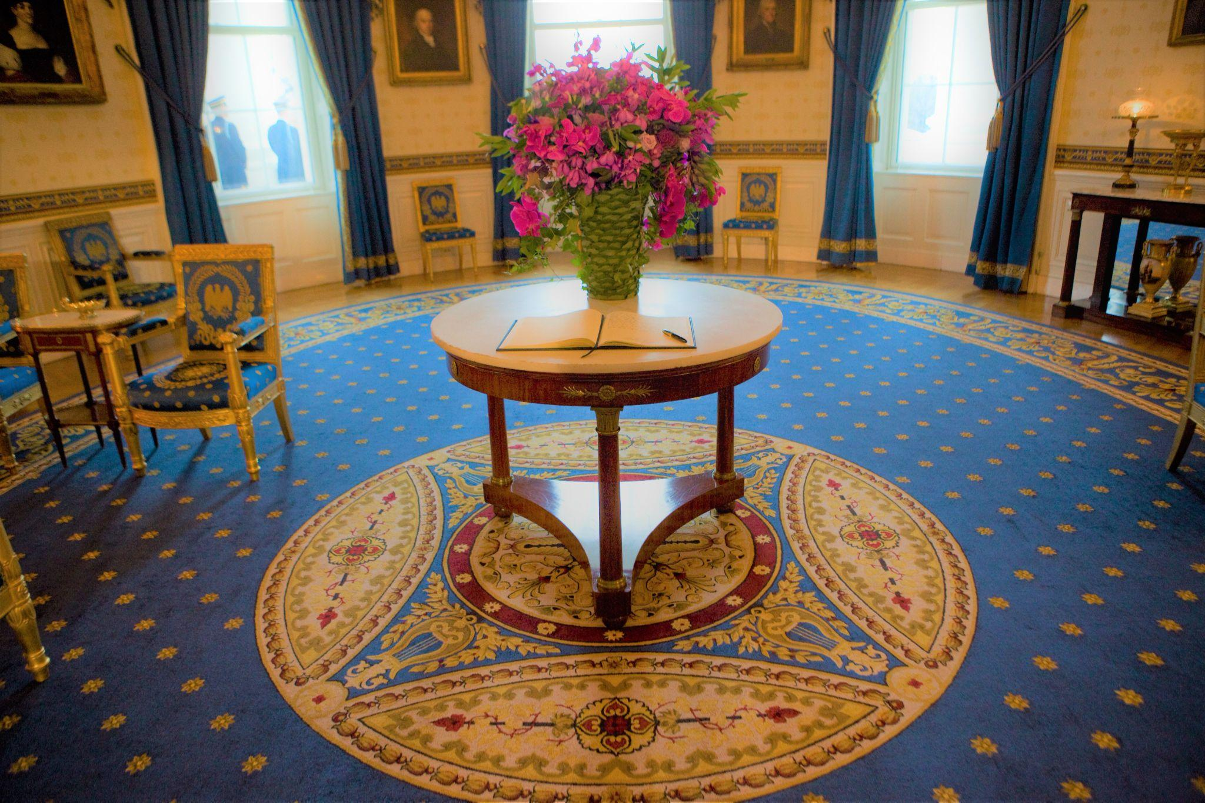
Laura Dowling:
L’Art du Bouquet
L

Slide 2
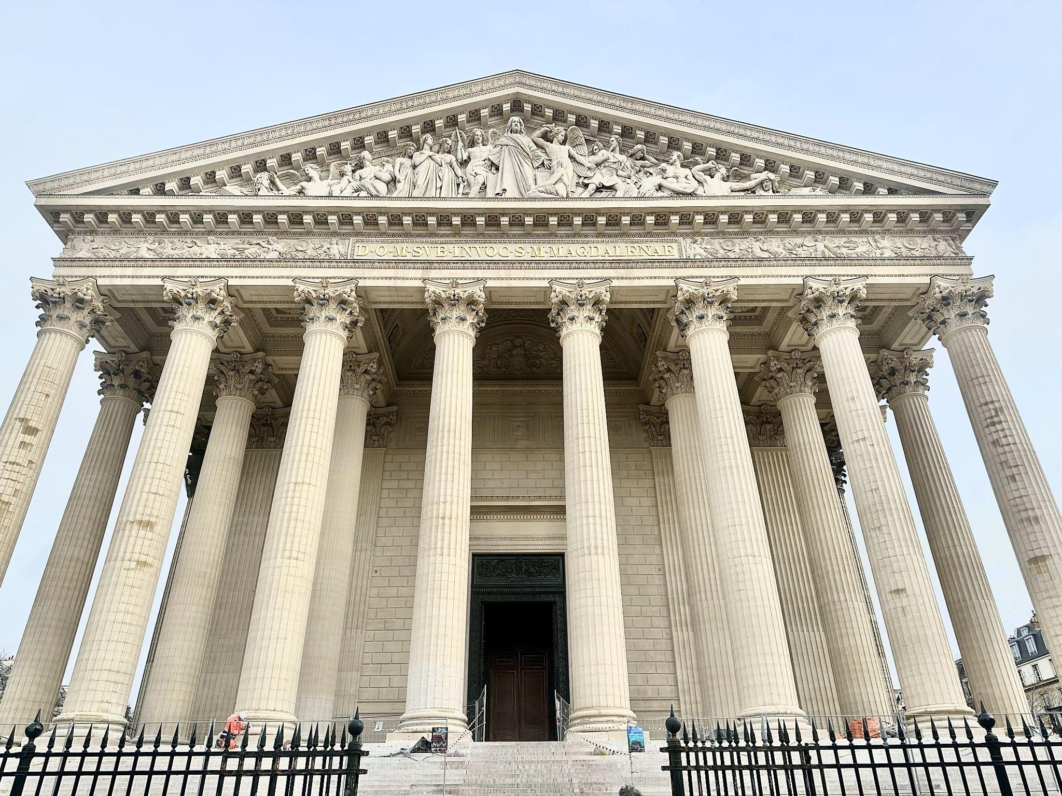
Paris Inspiration 2025

Slide 3
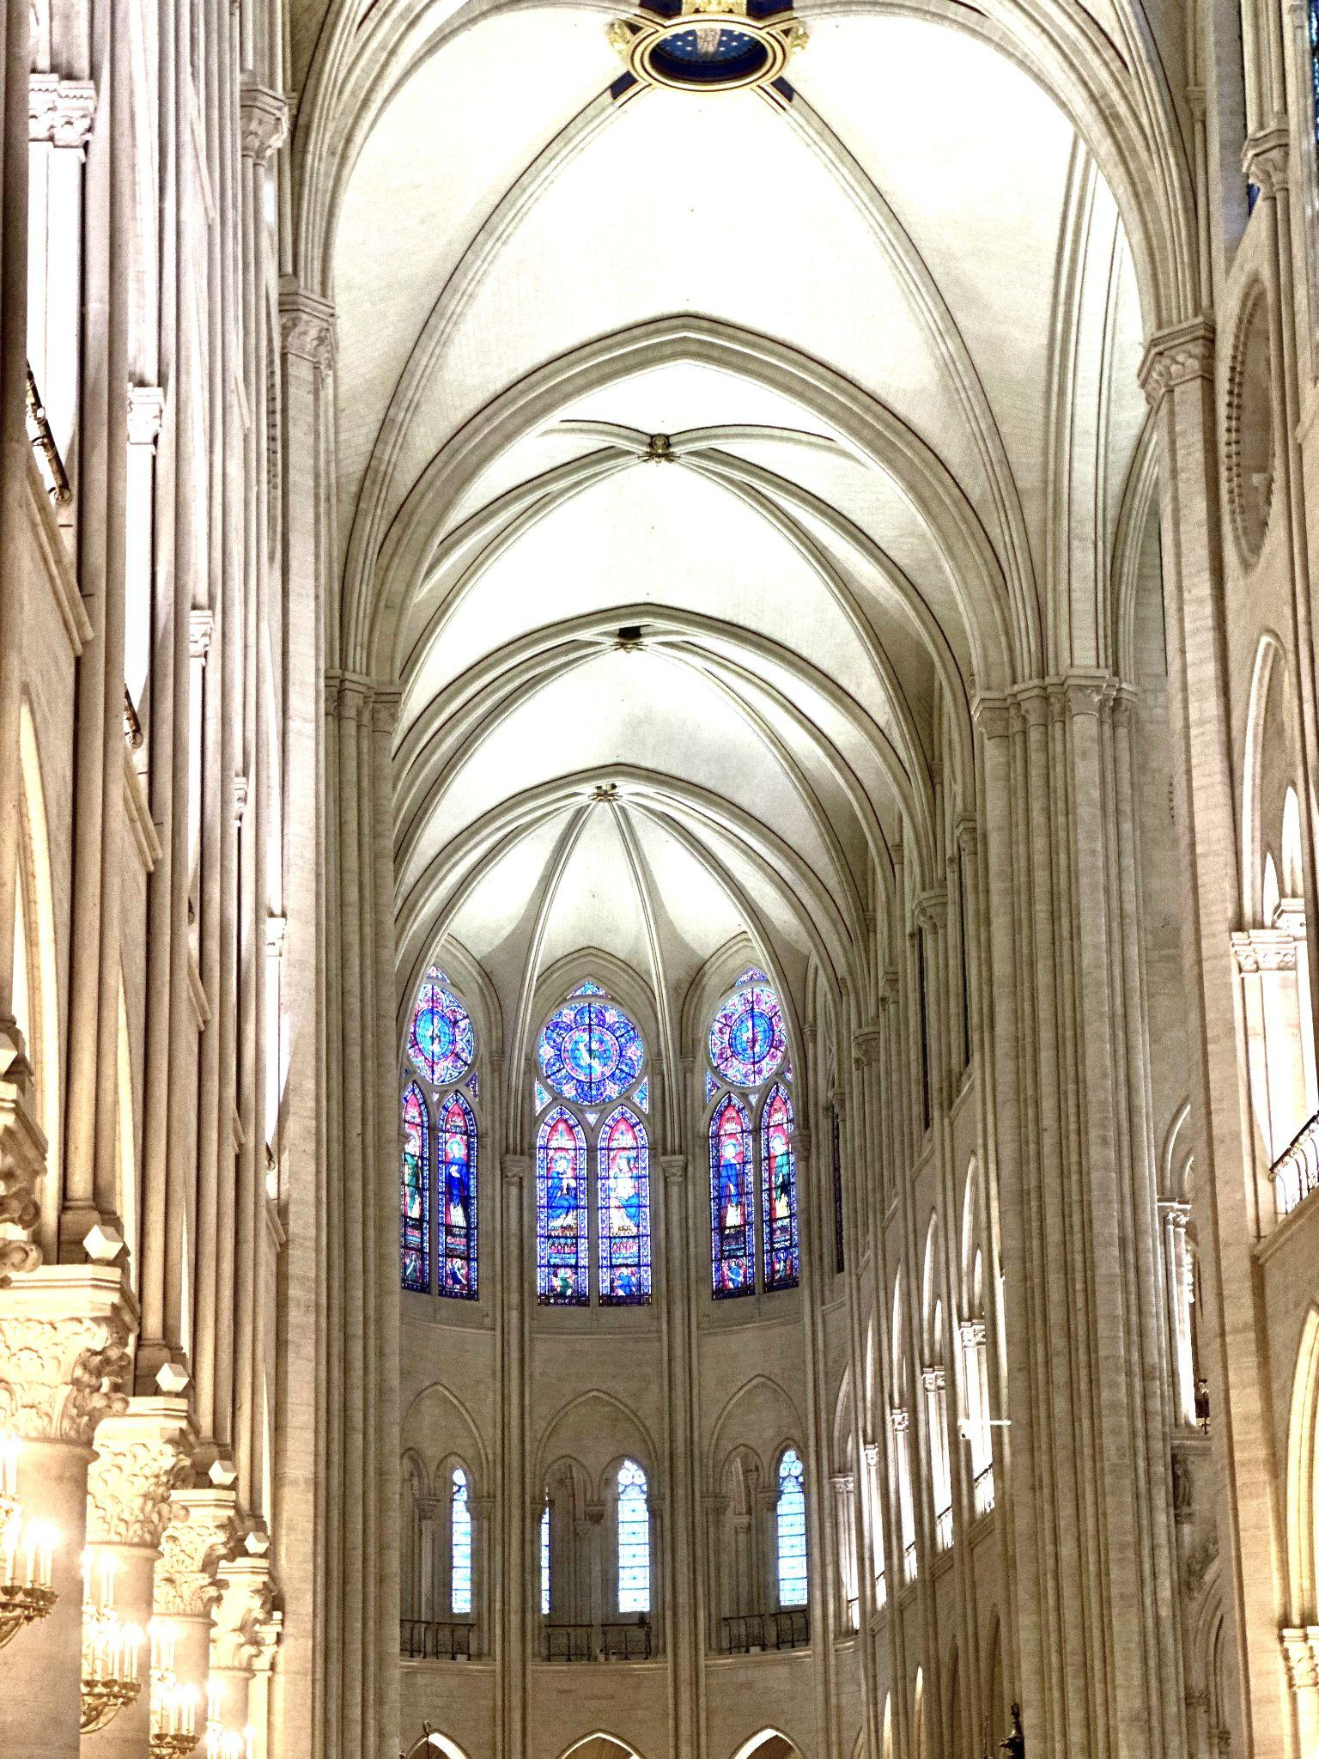
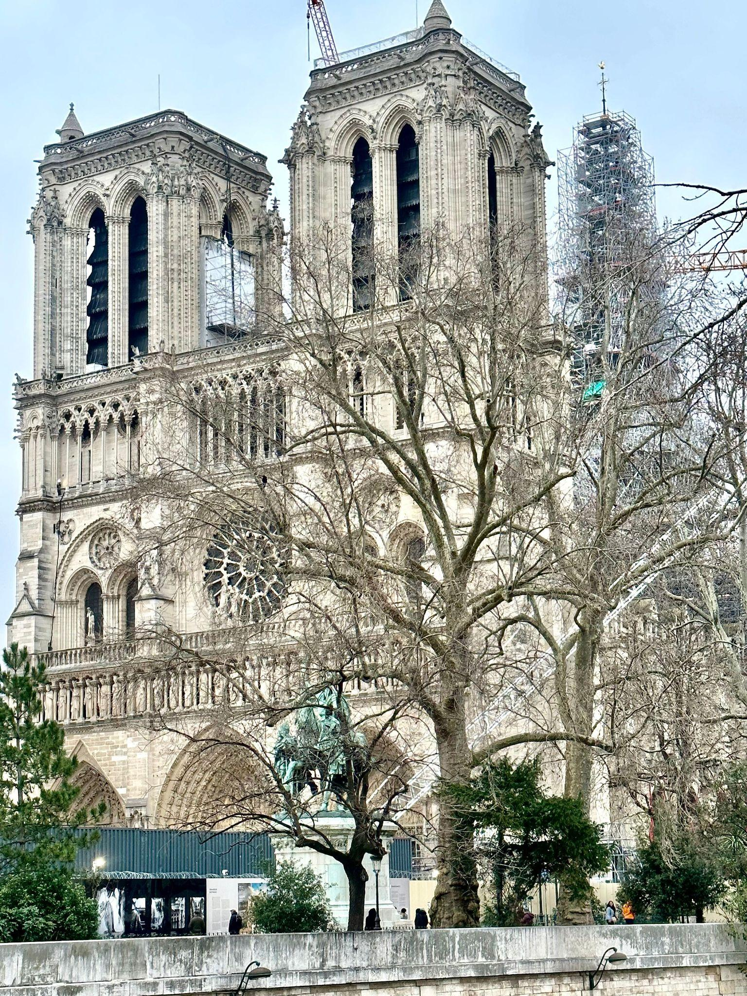

Slide 4
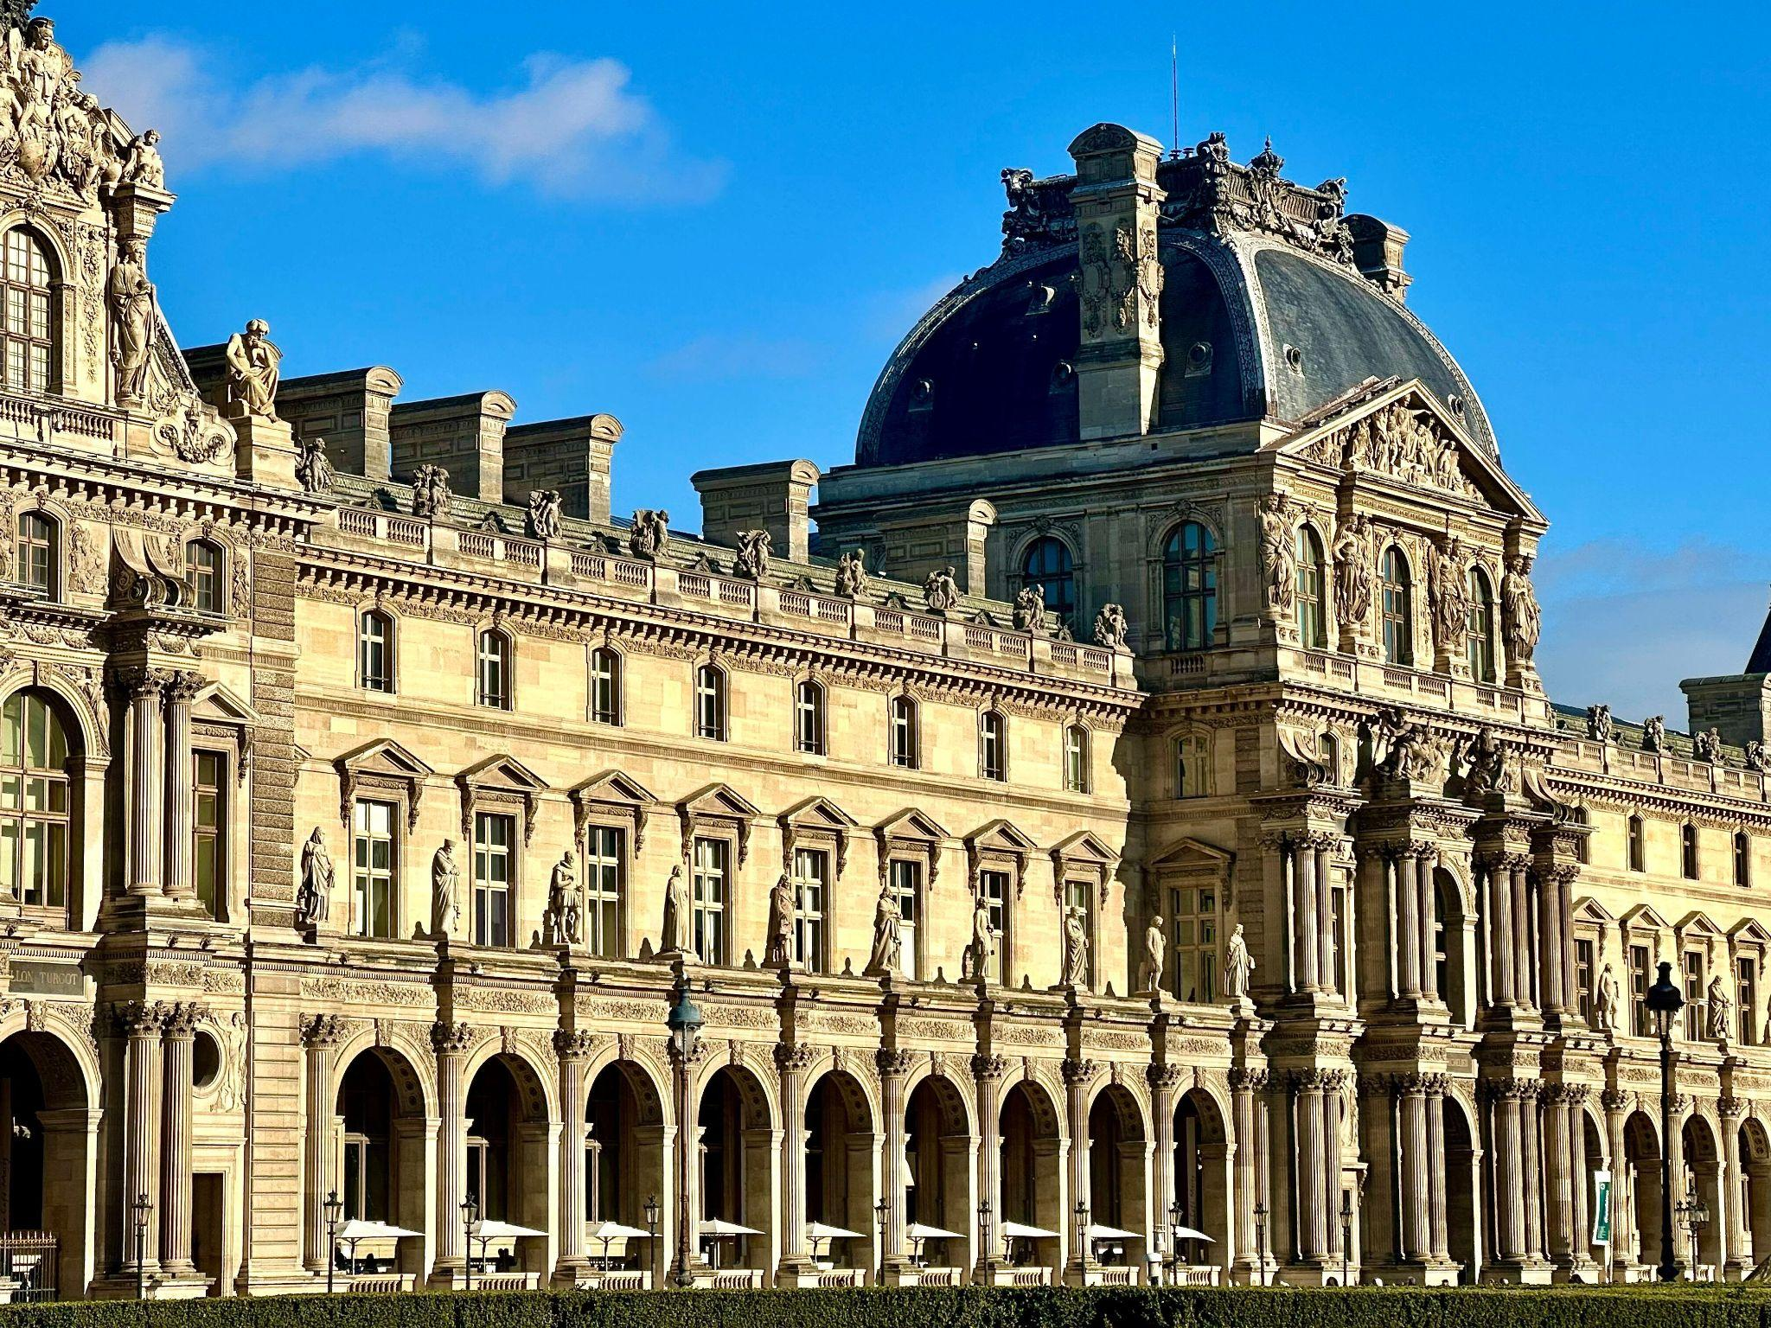

Slide 5
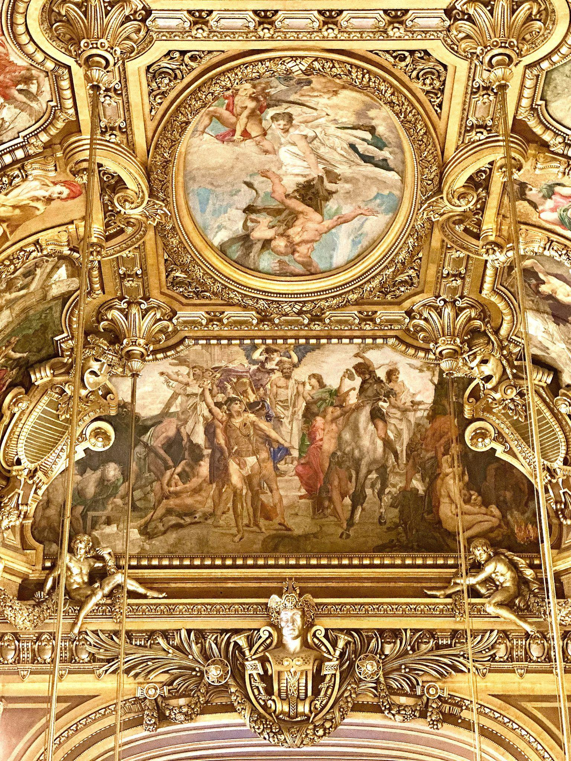
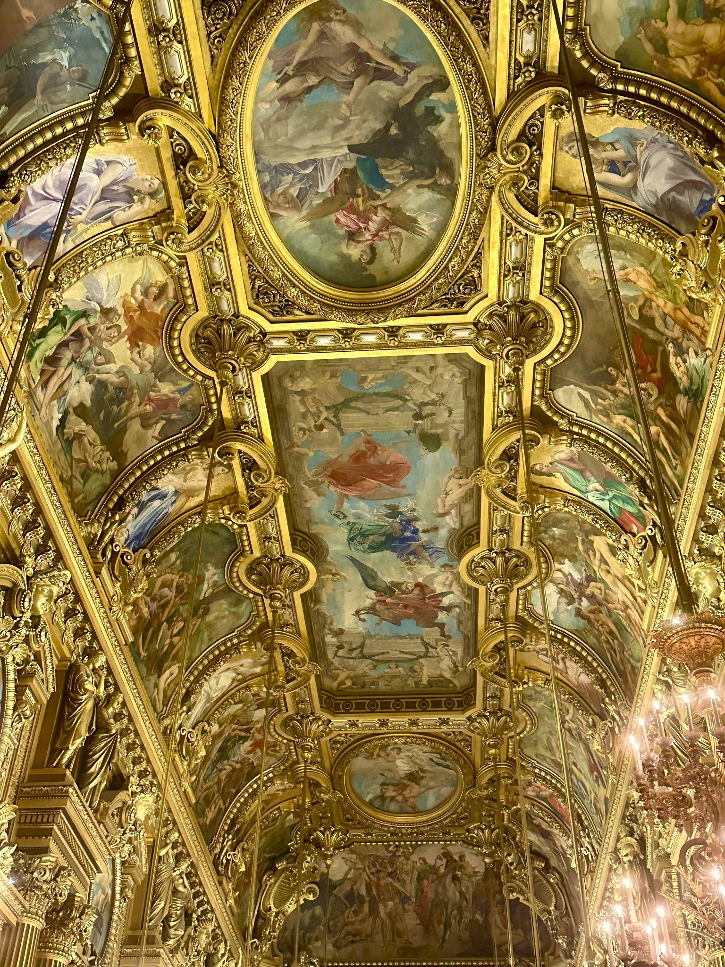

Slide 6
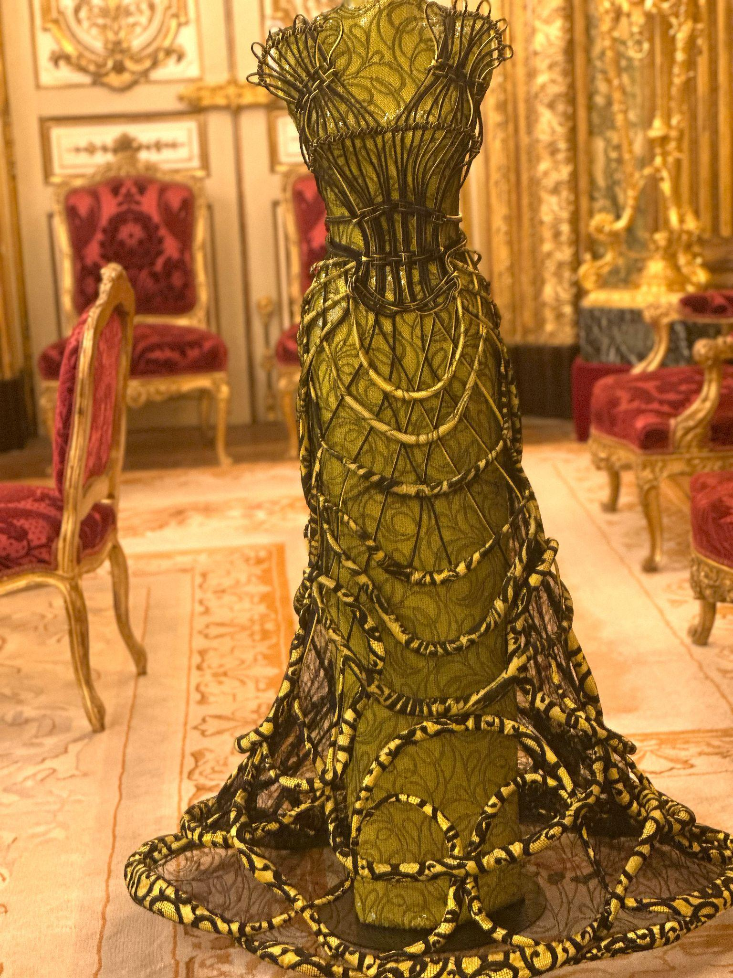
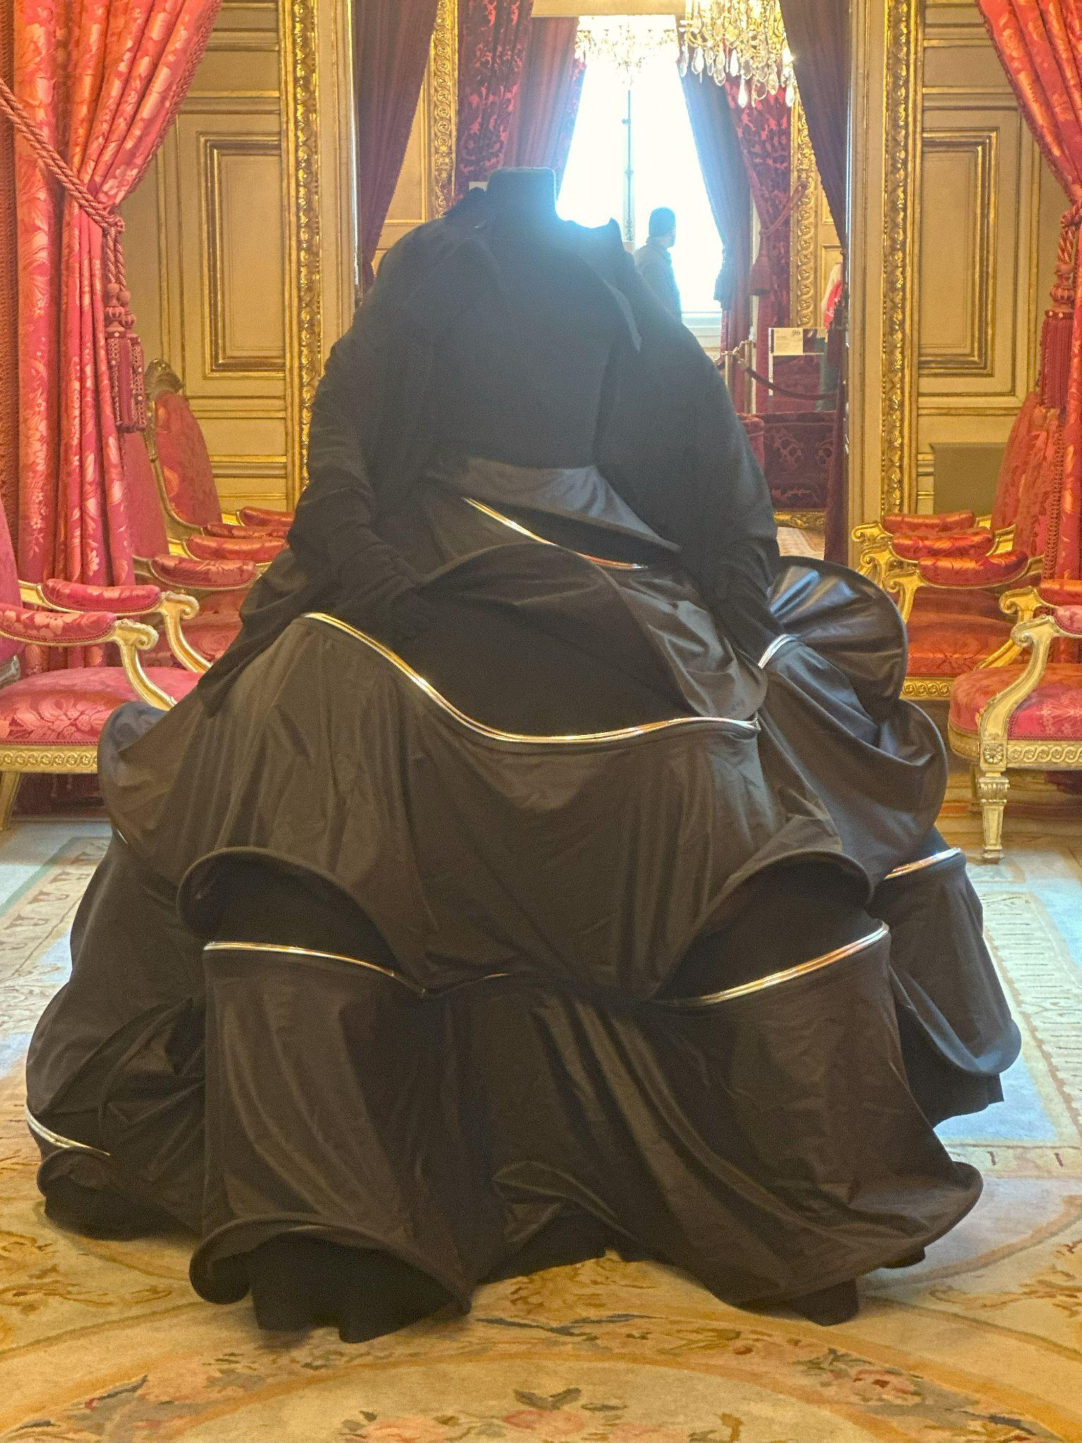

Slide 7
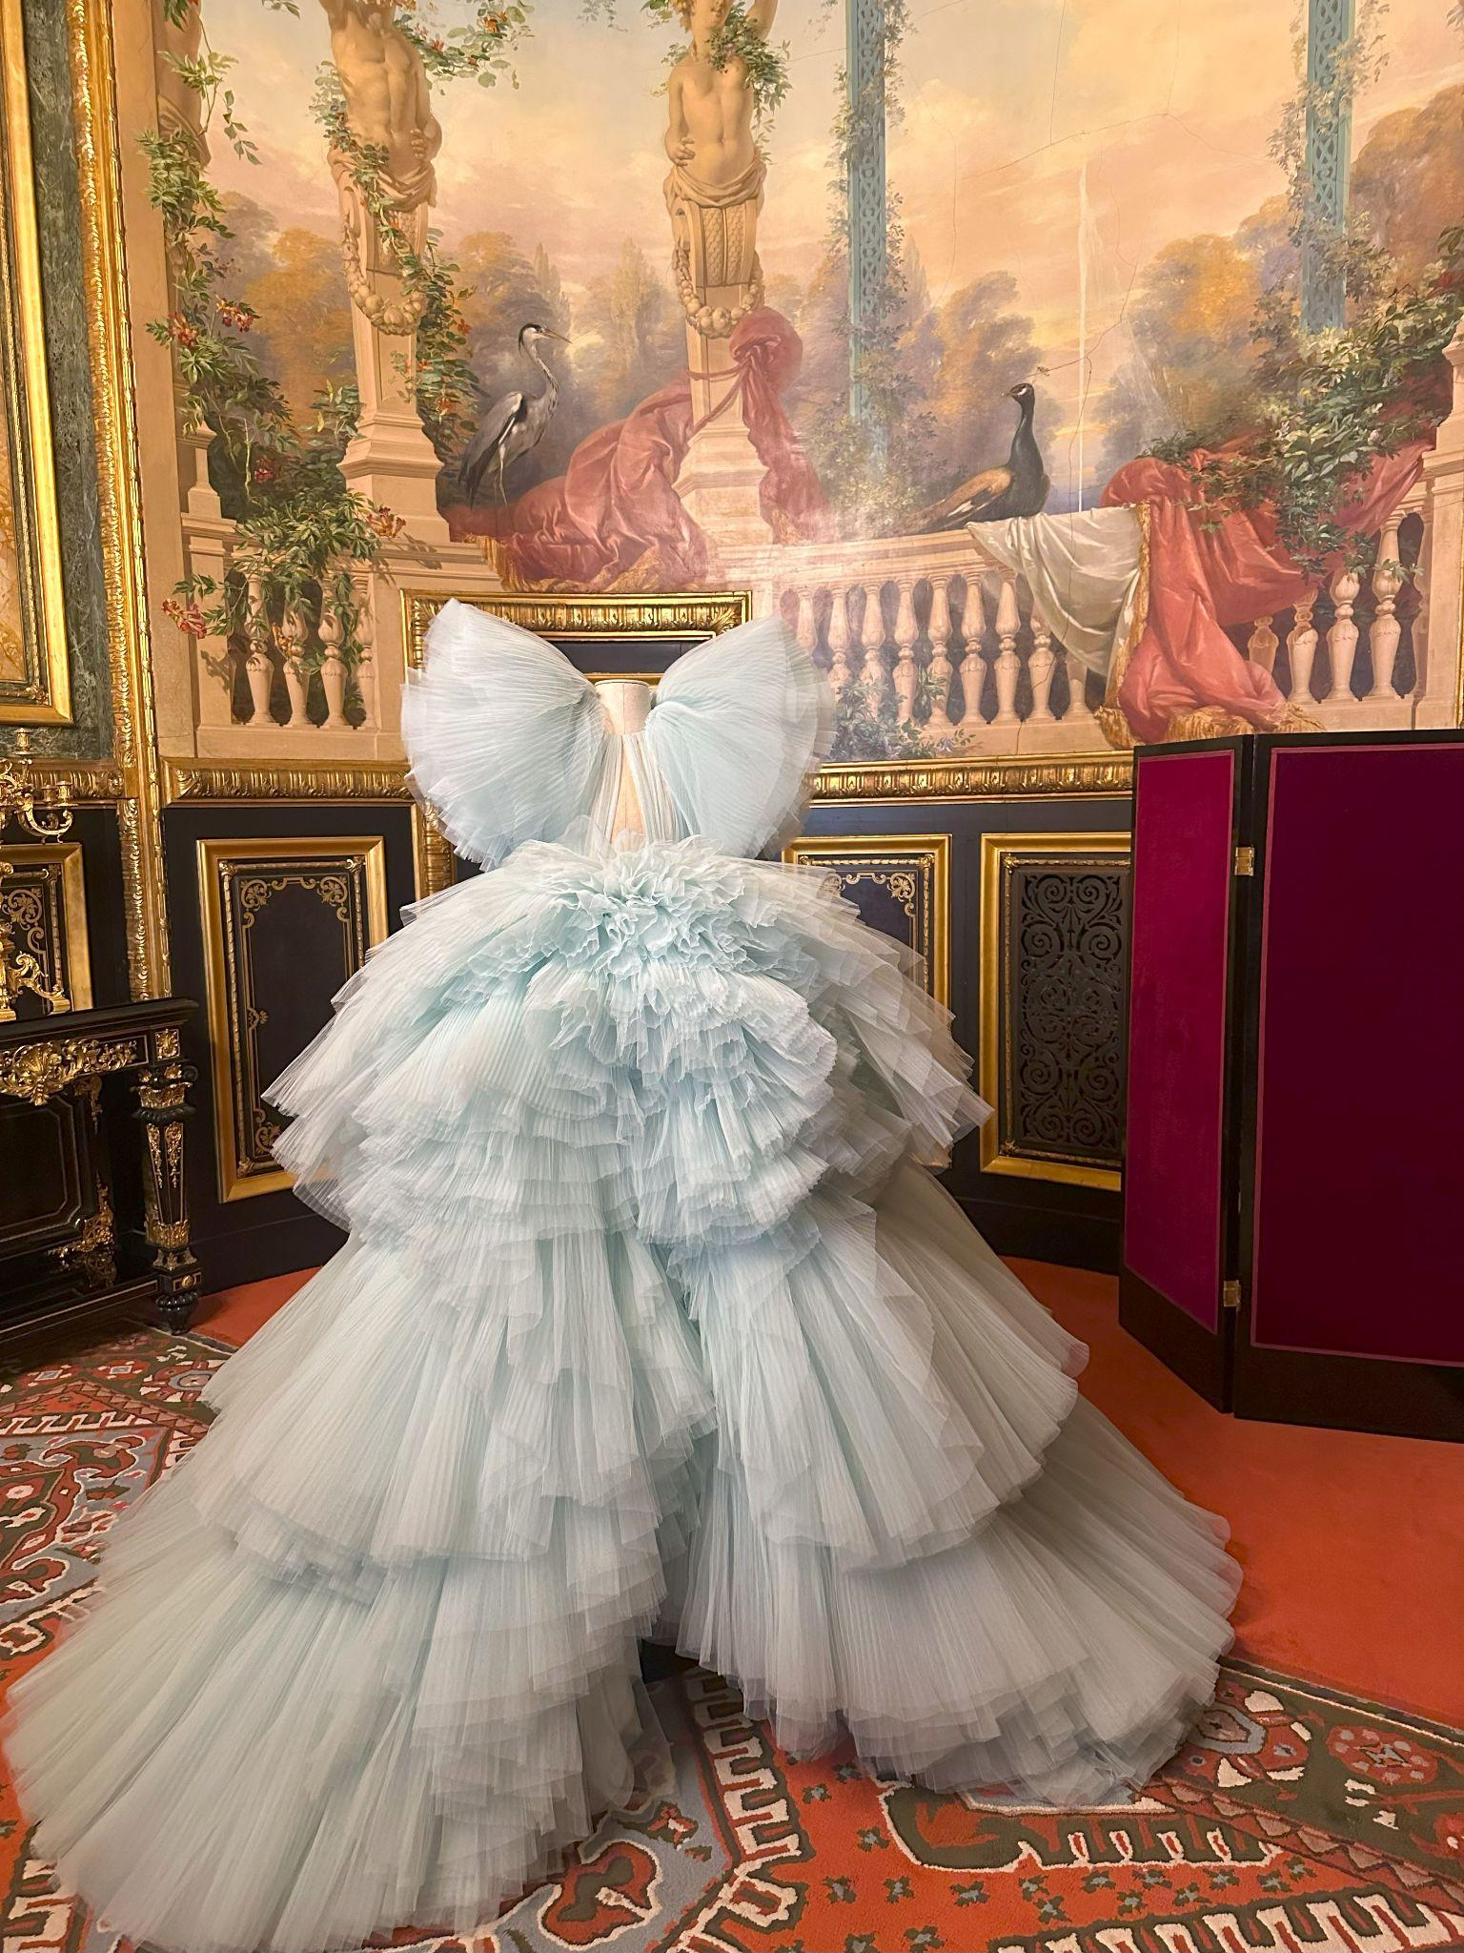
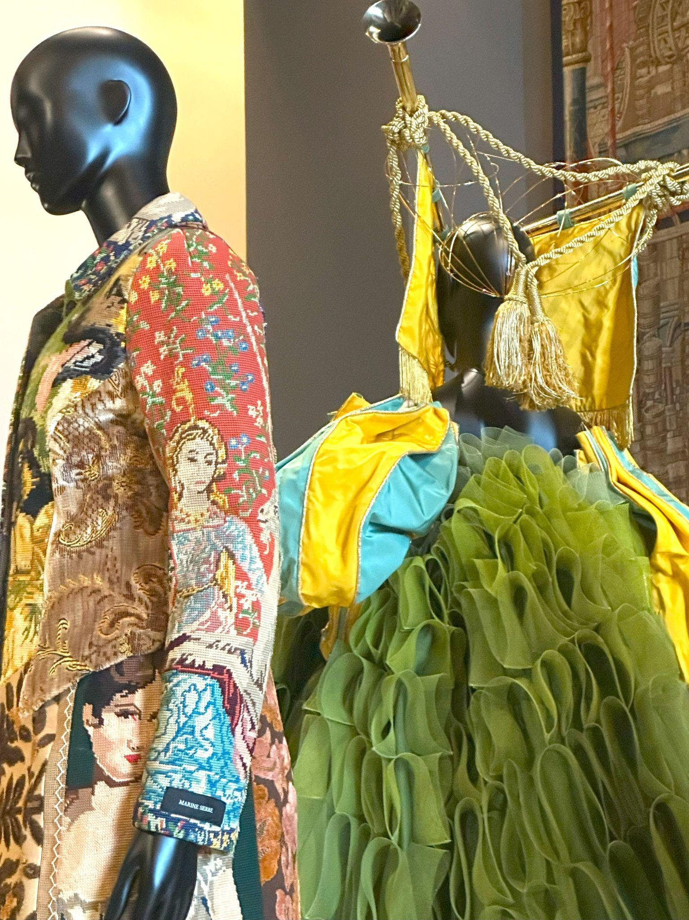

Slide 8
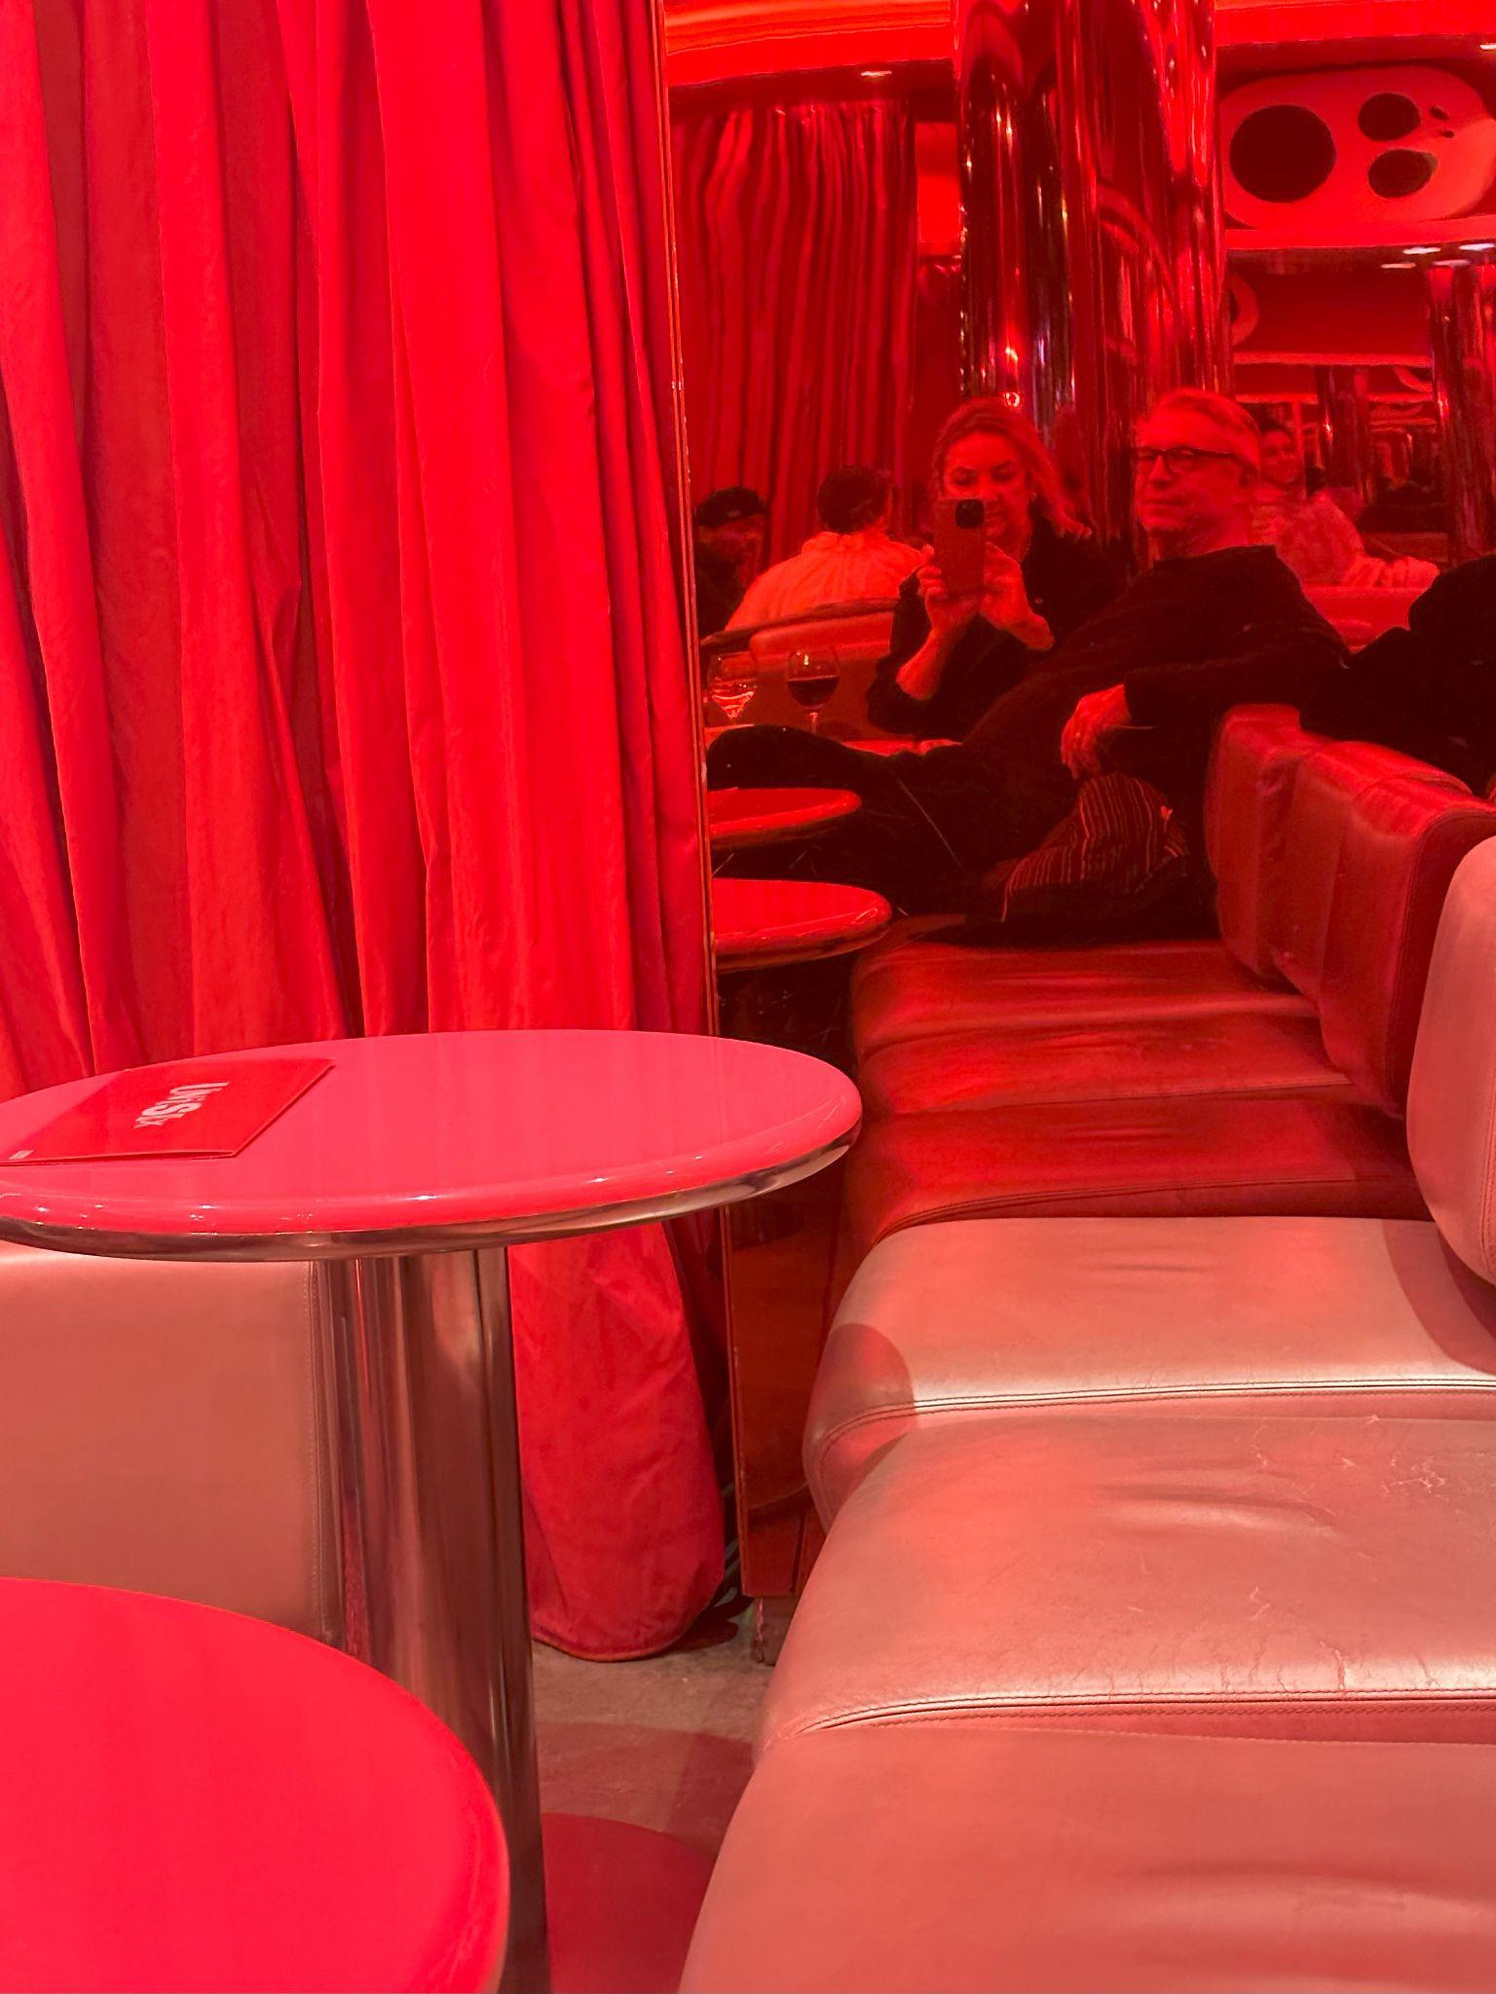
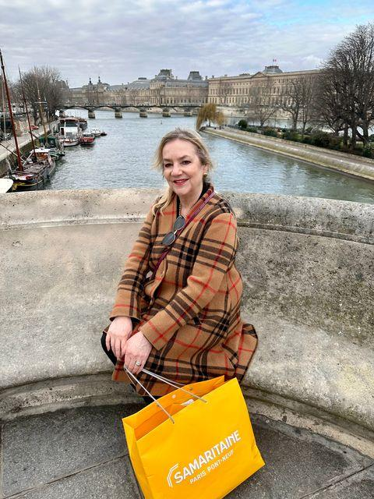

Slide 9
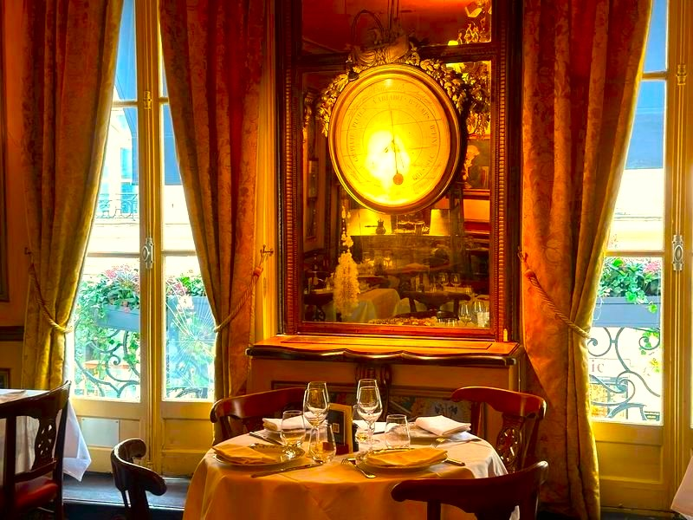

Slide 10
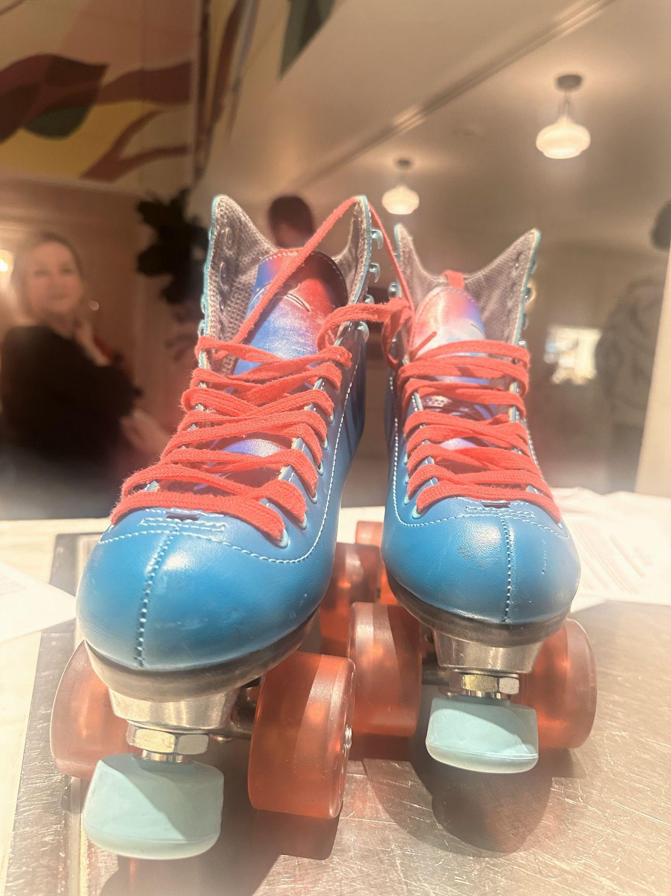
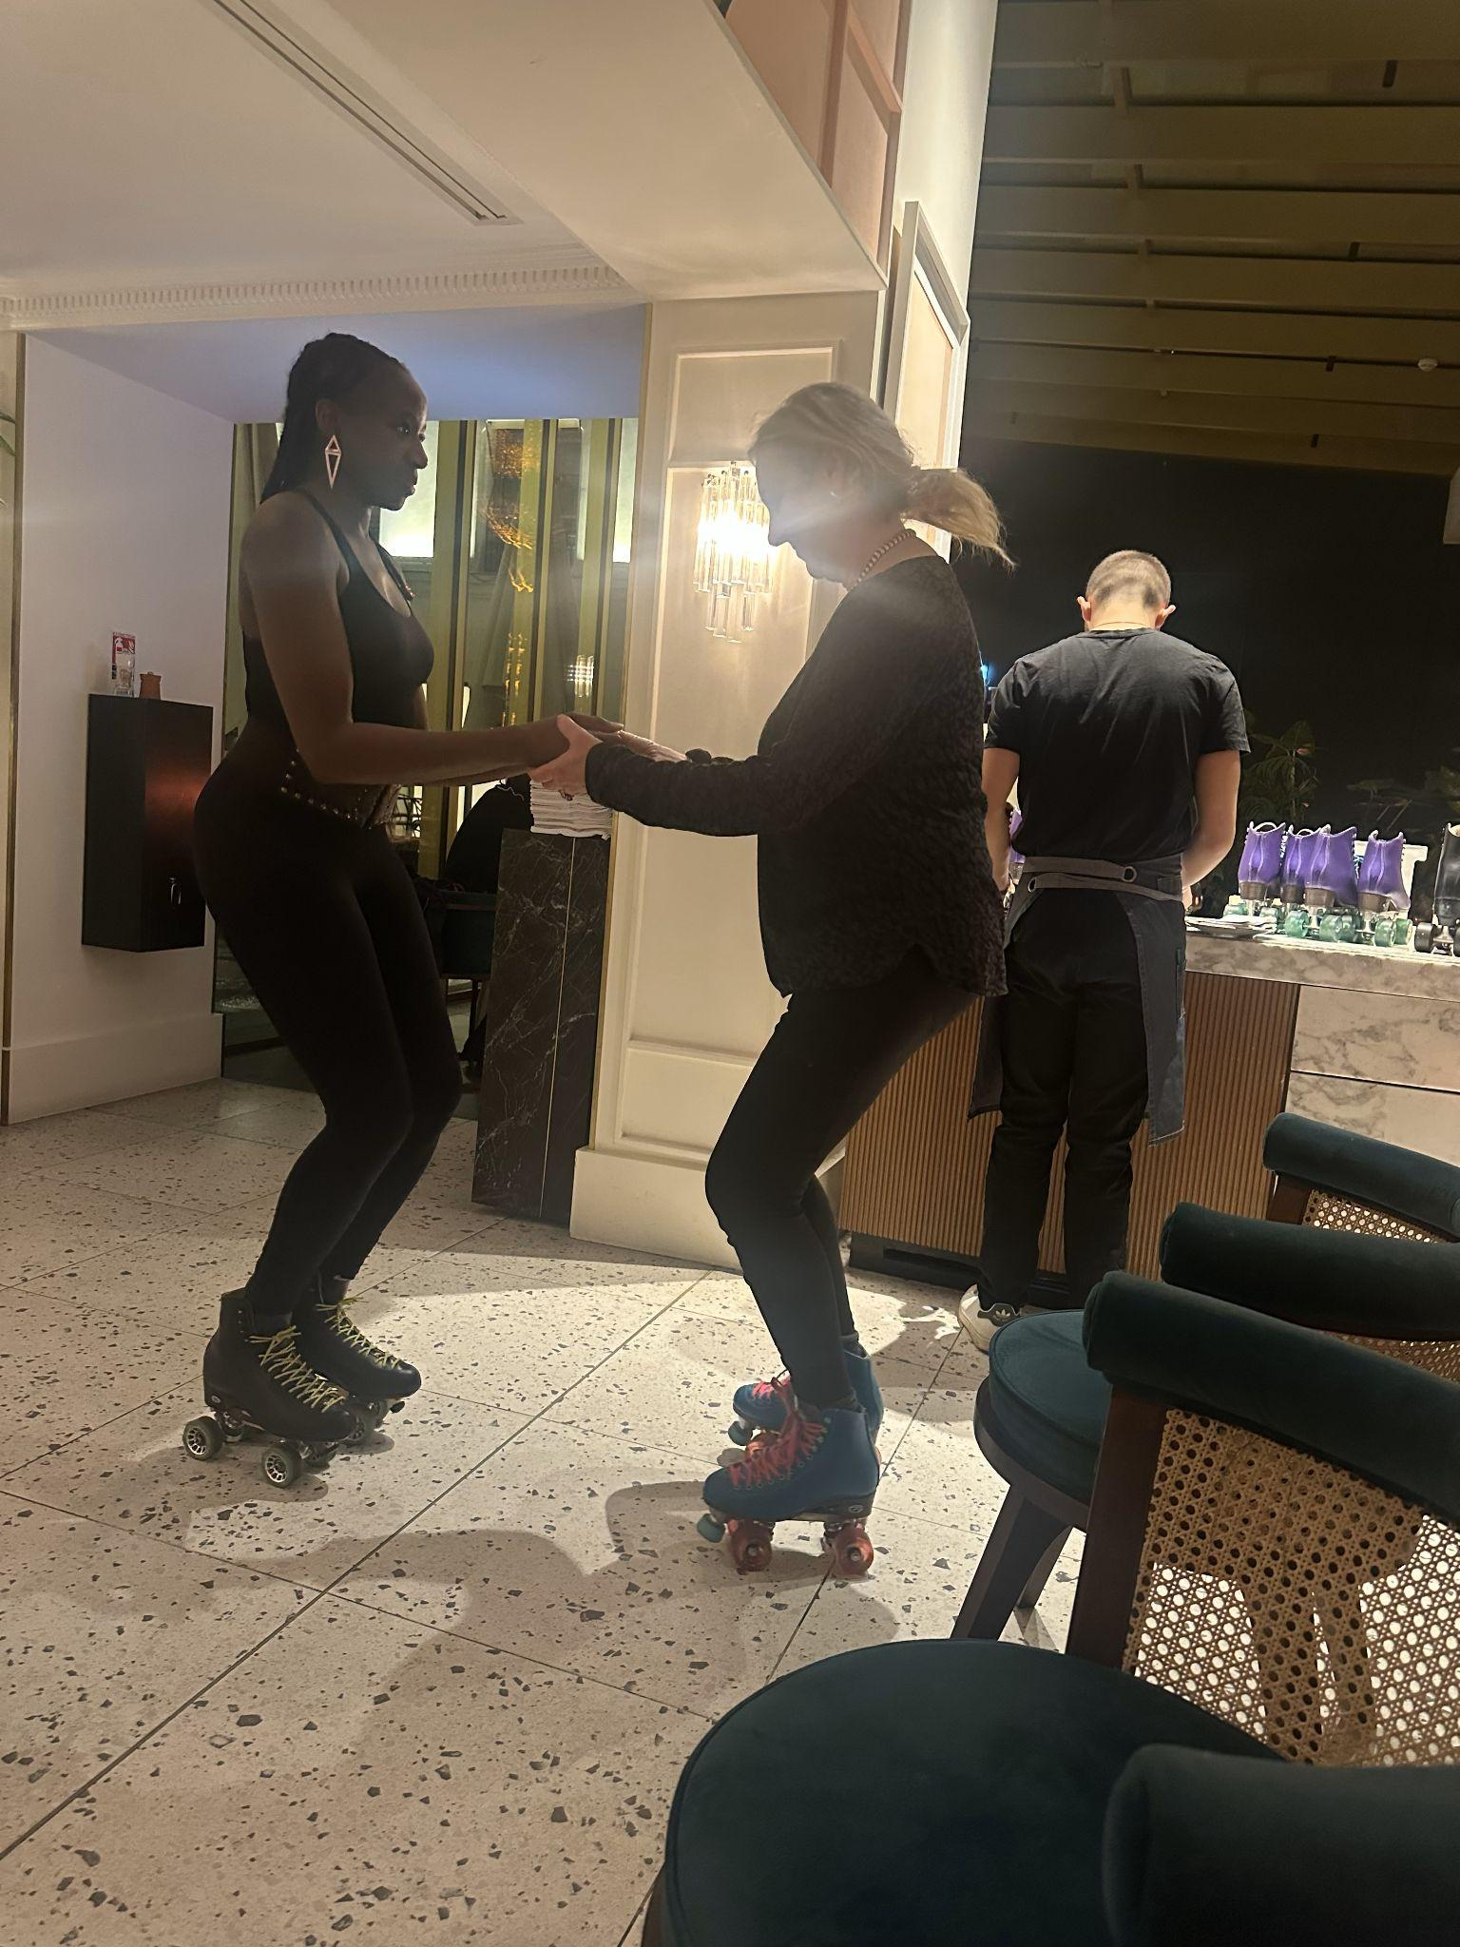

Slide 11
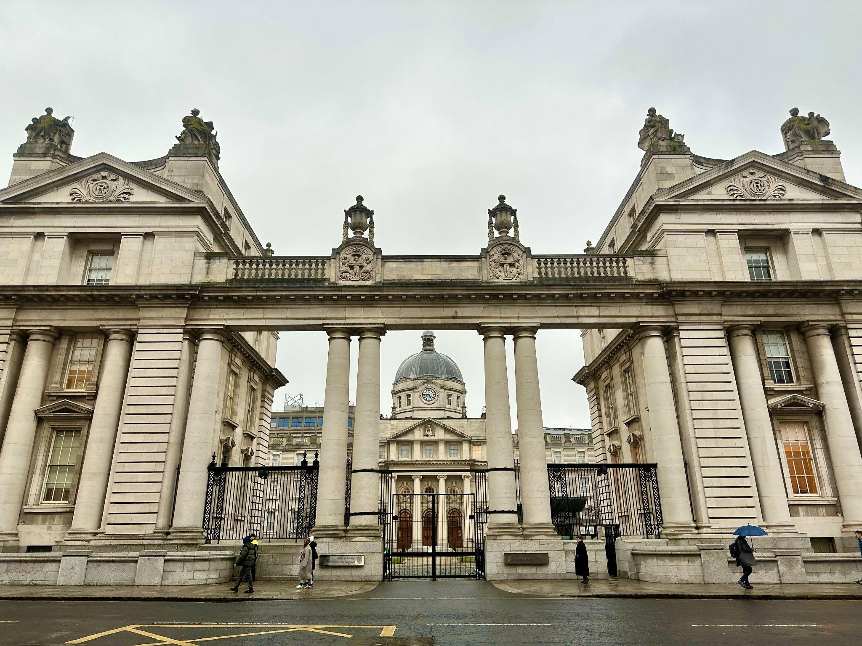
Irish Inspiration – 2025

Slide 12
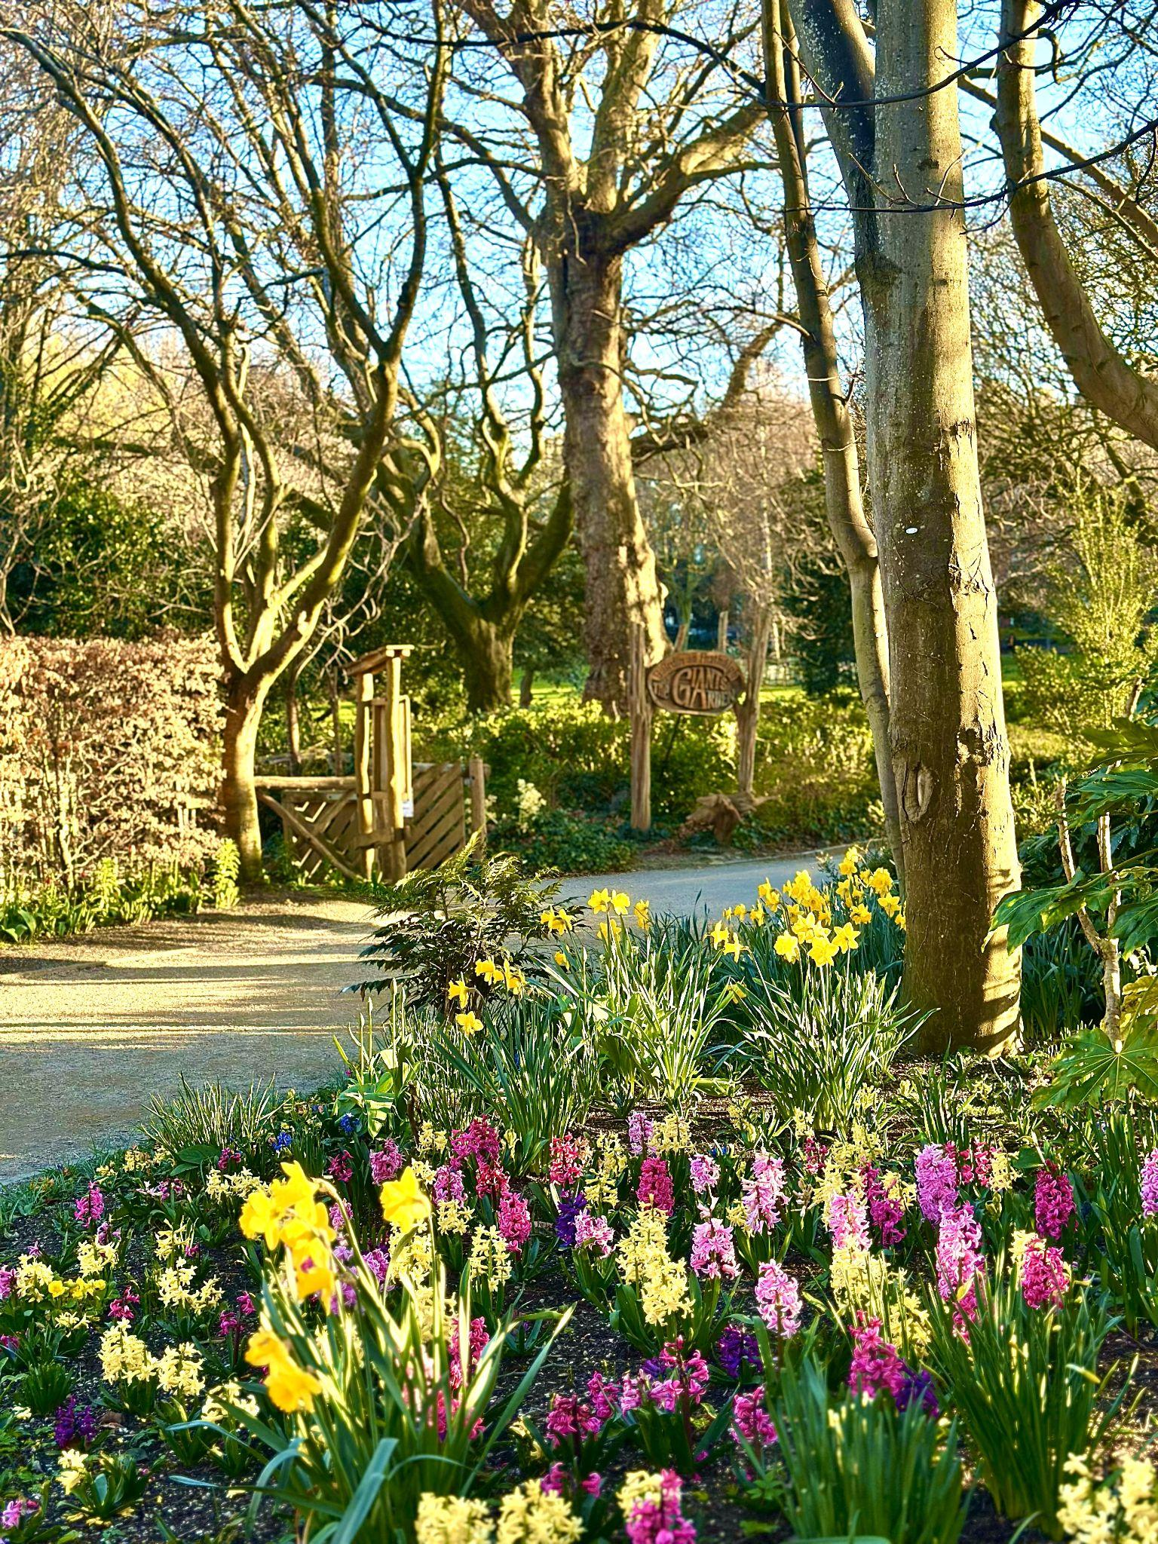
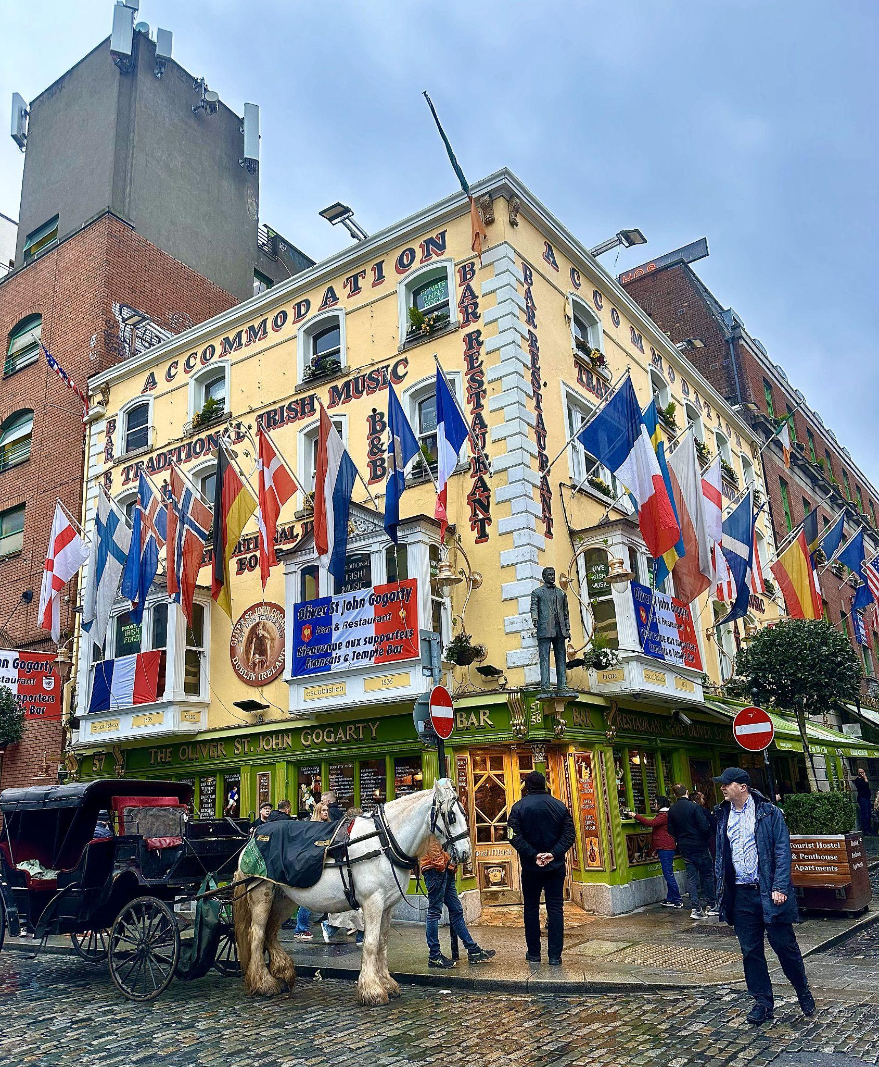

Slide 13


Slide 14
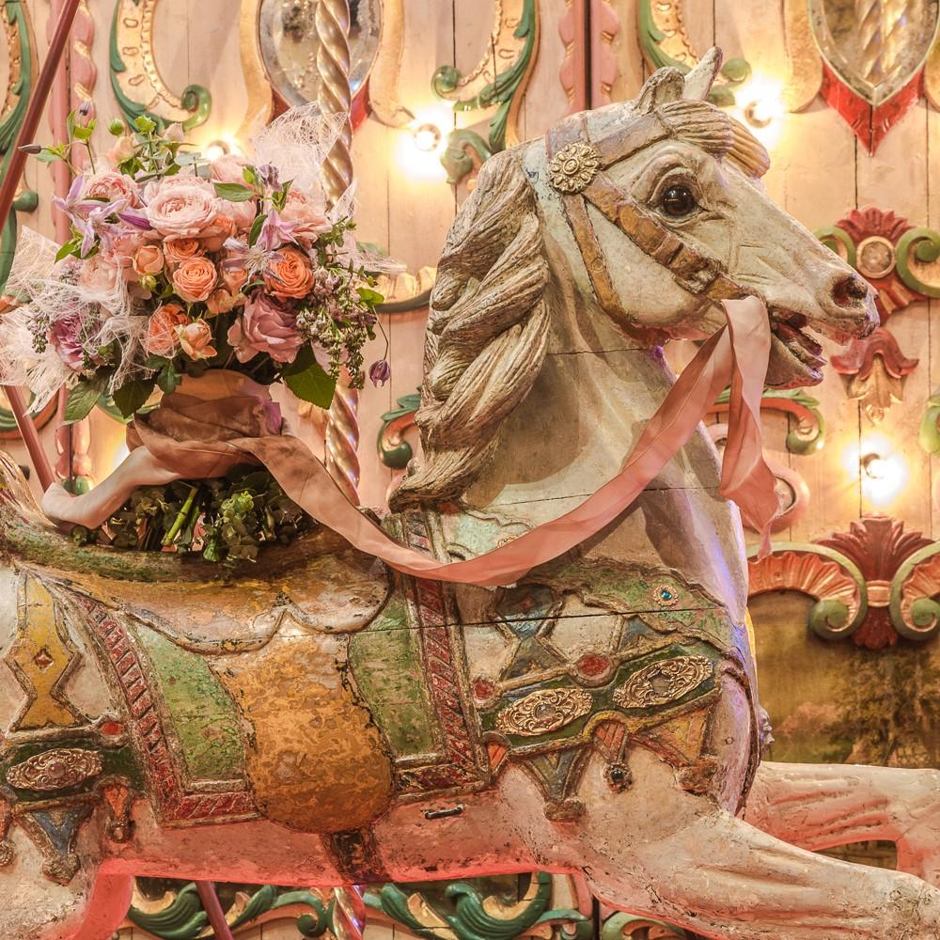
Seasonal Inspiration

Slide 15
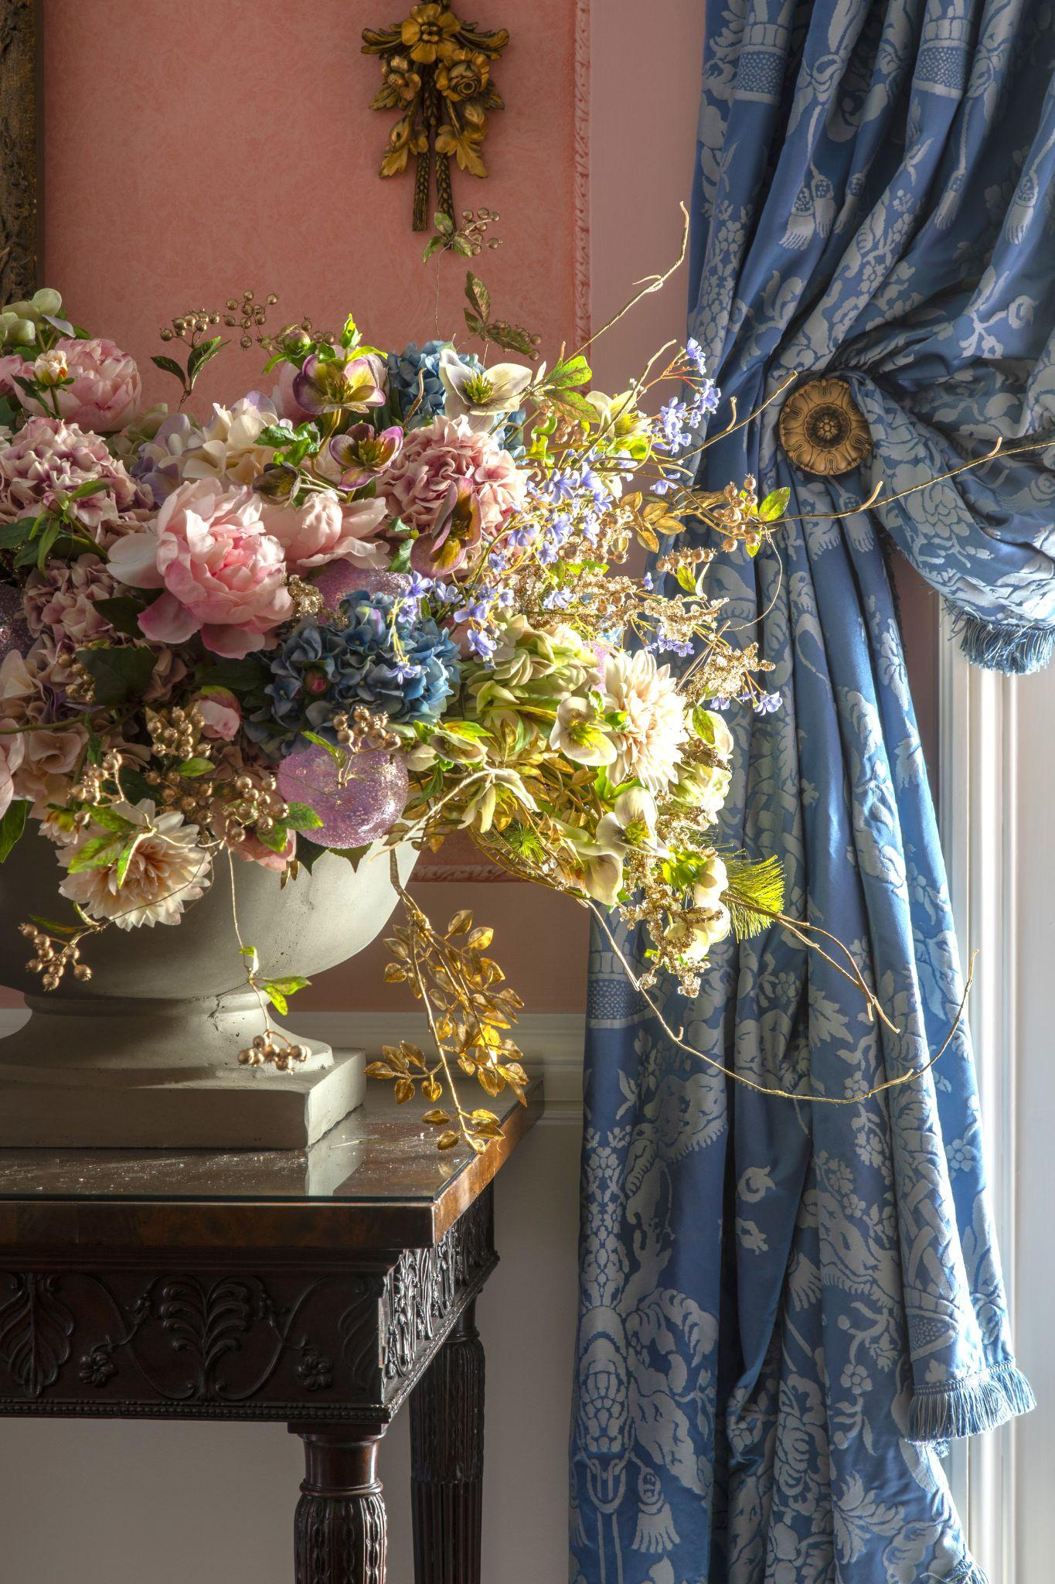
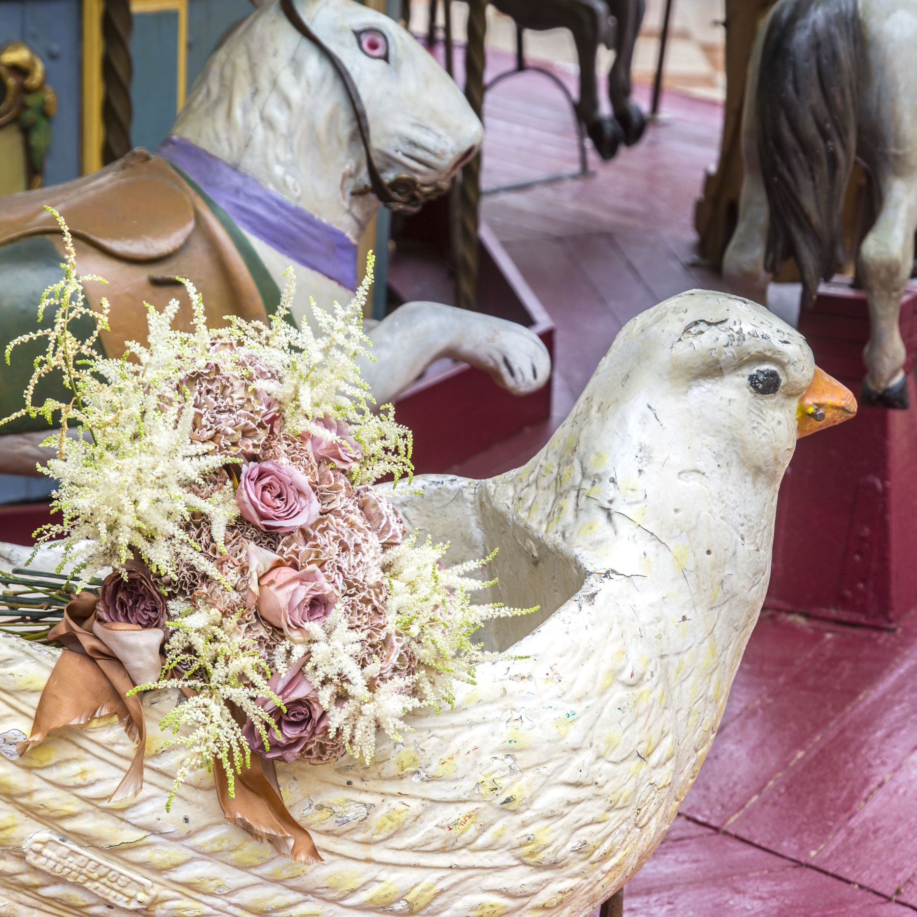
Spring!

Slide 16
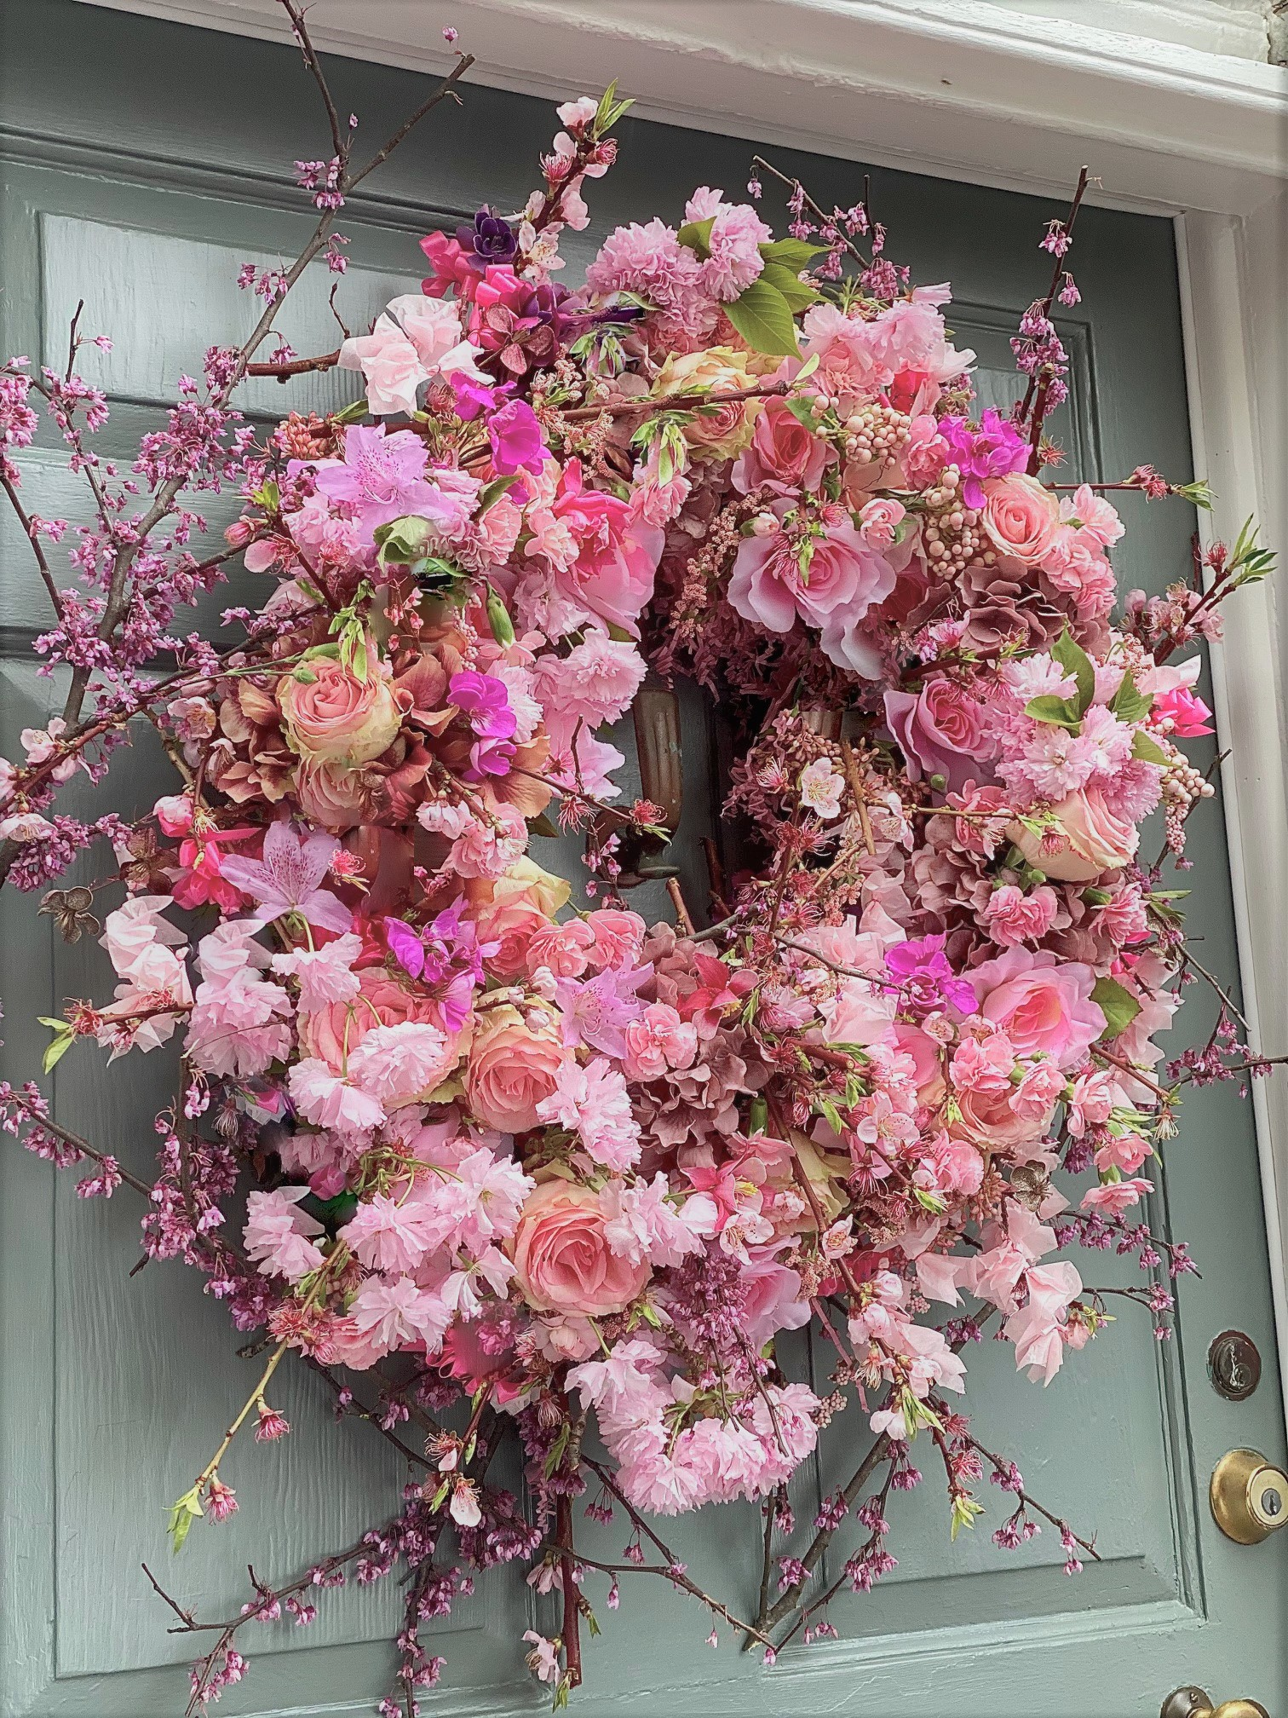
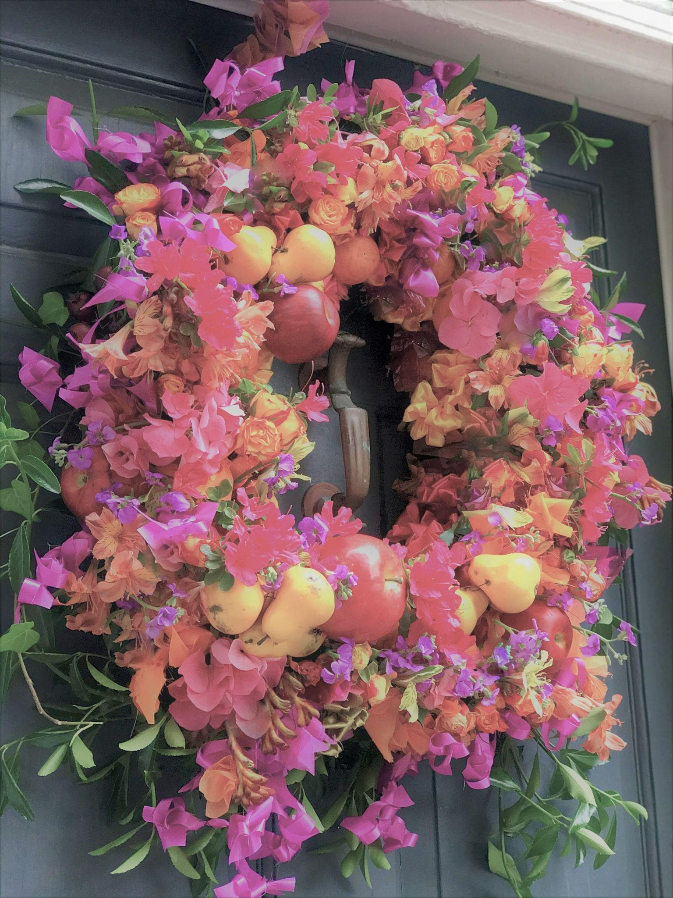

Slide 17
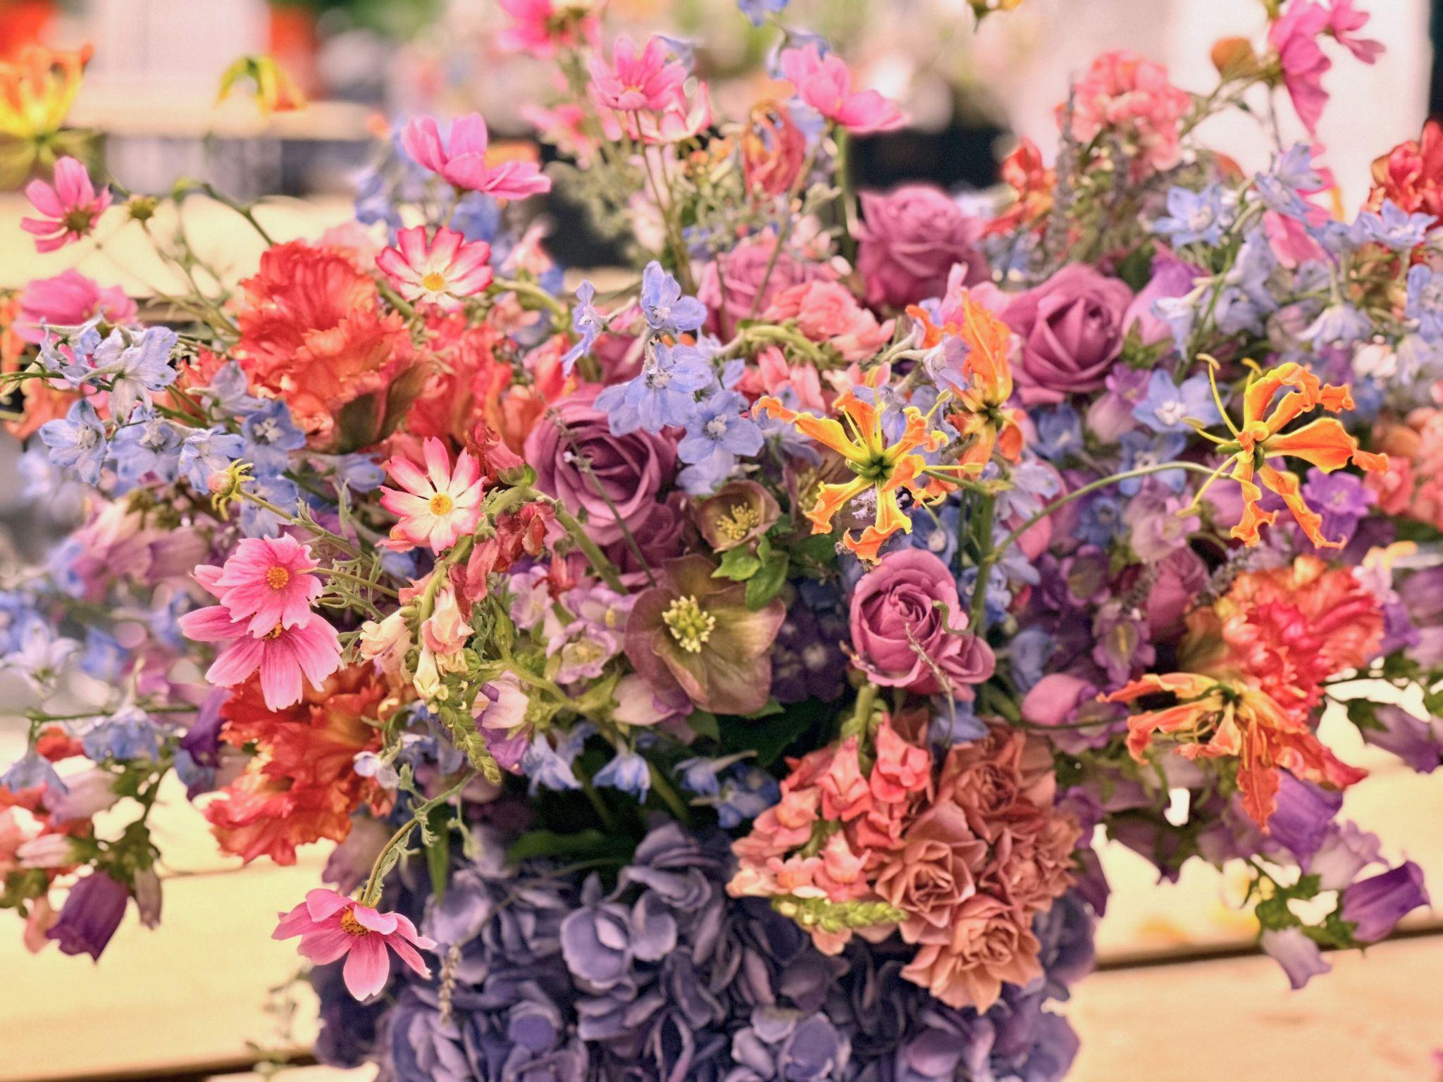

Slide 18
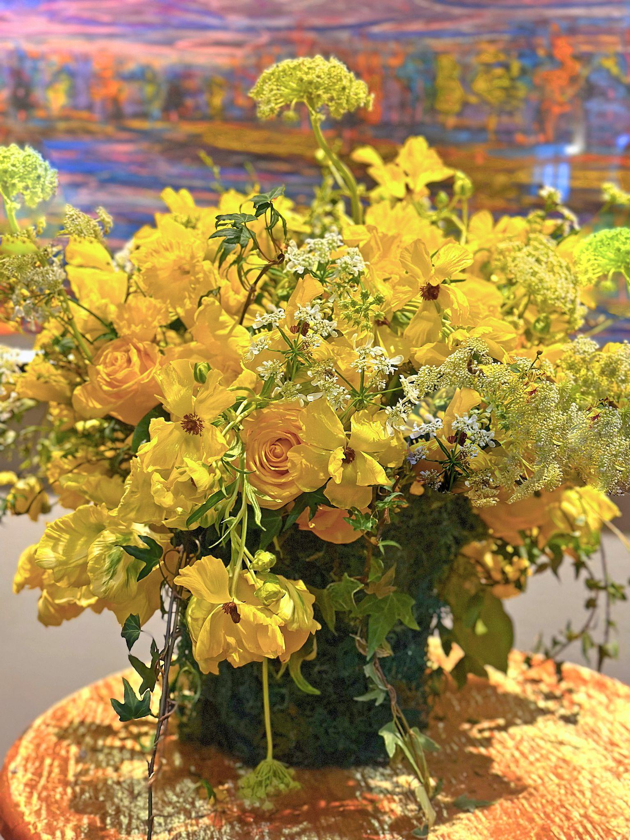
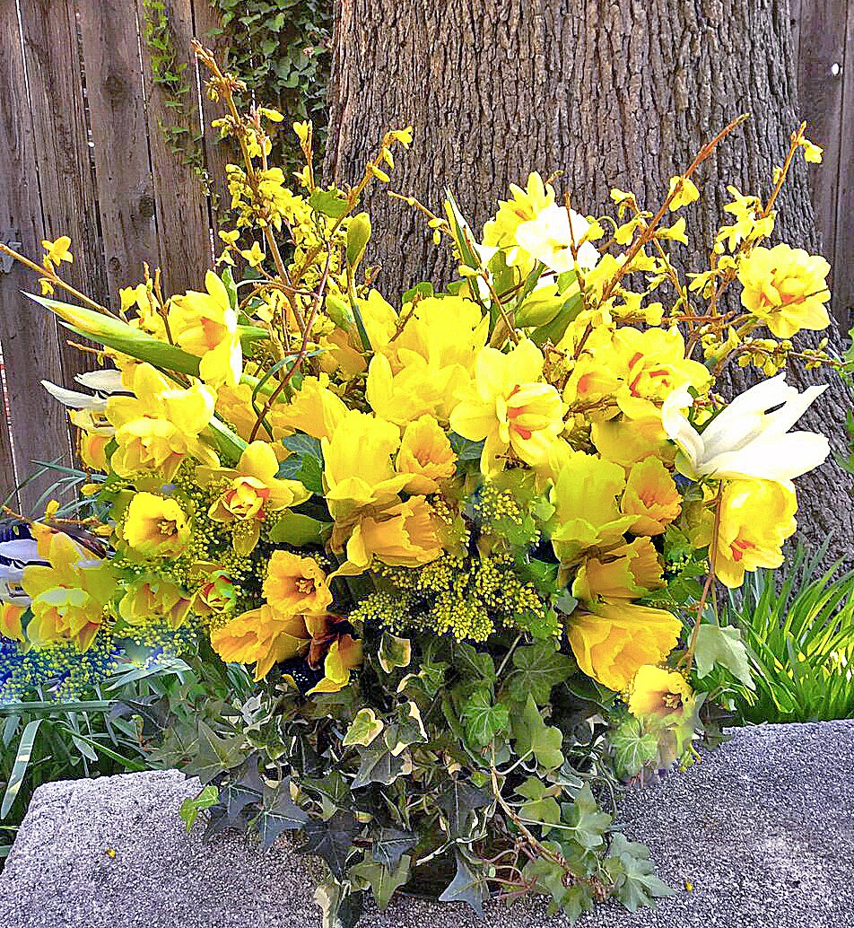

Slide 19
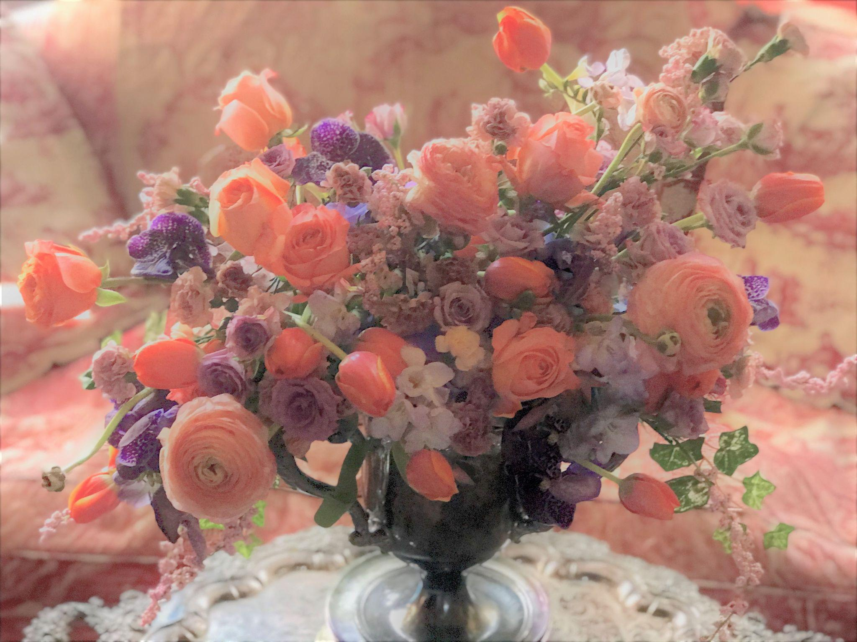

Slide 20
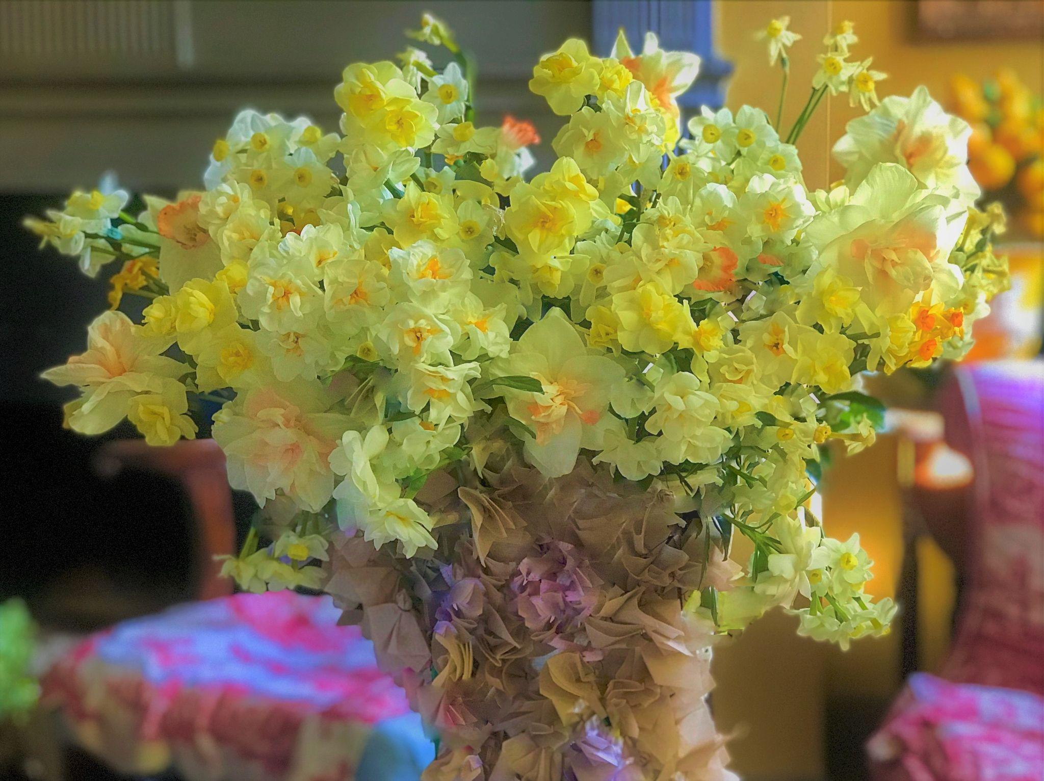

Slide 21
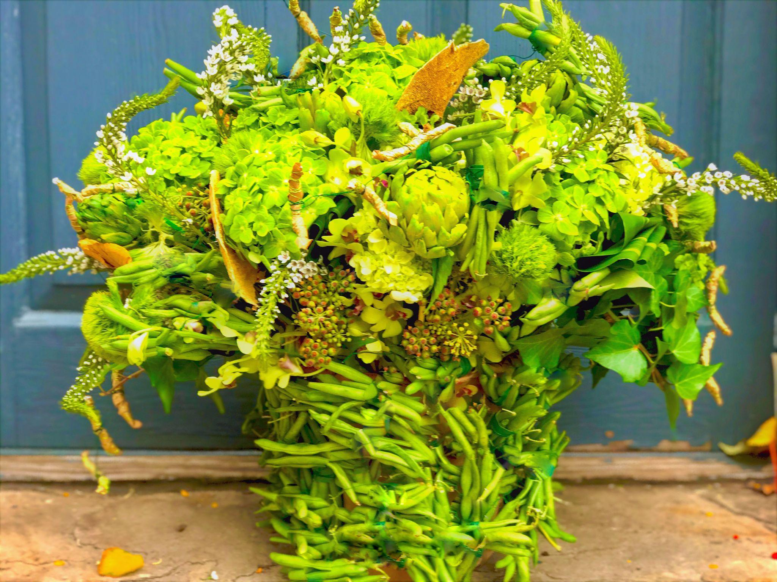

Slide 22
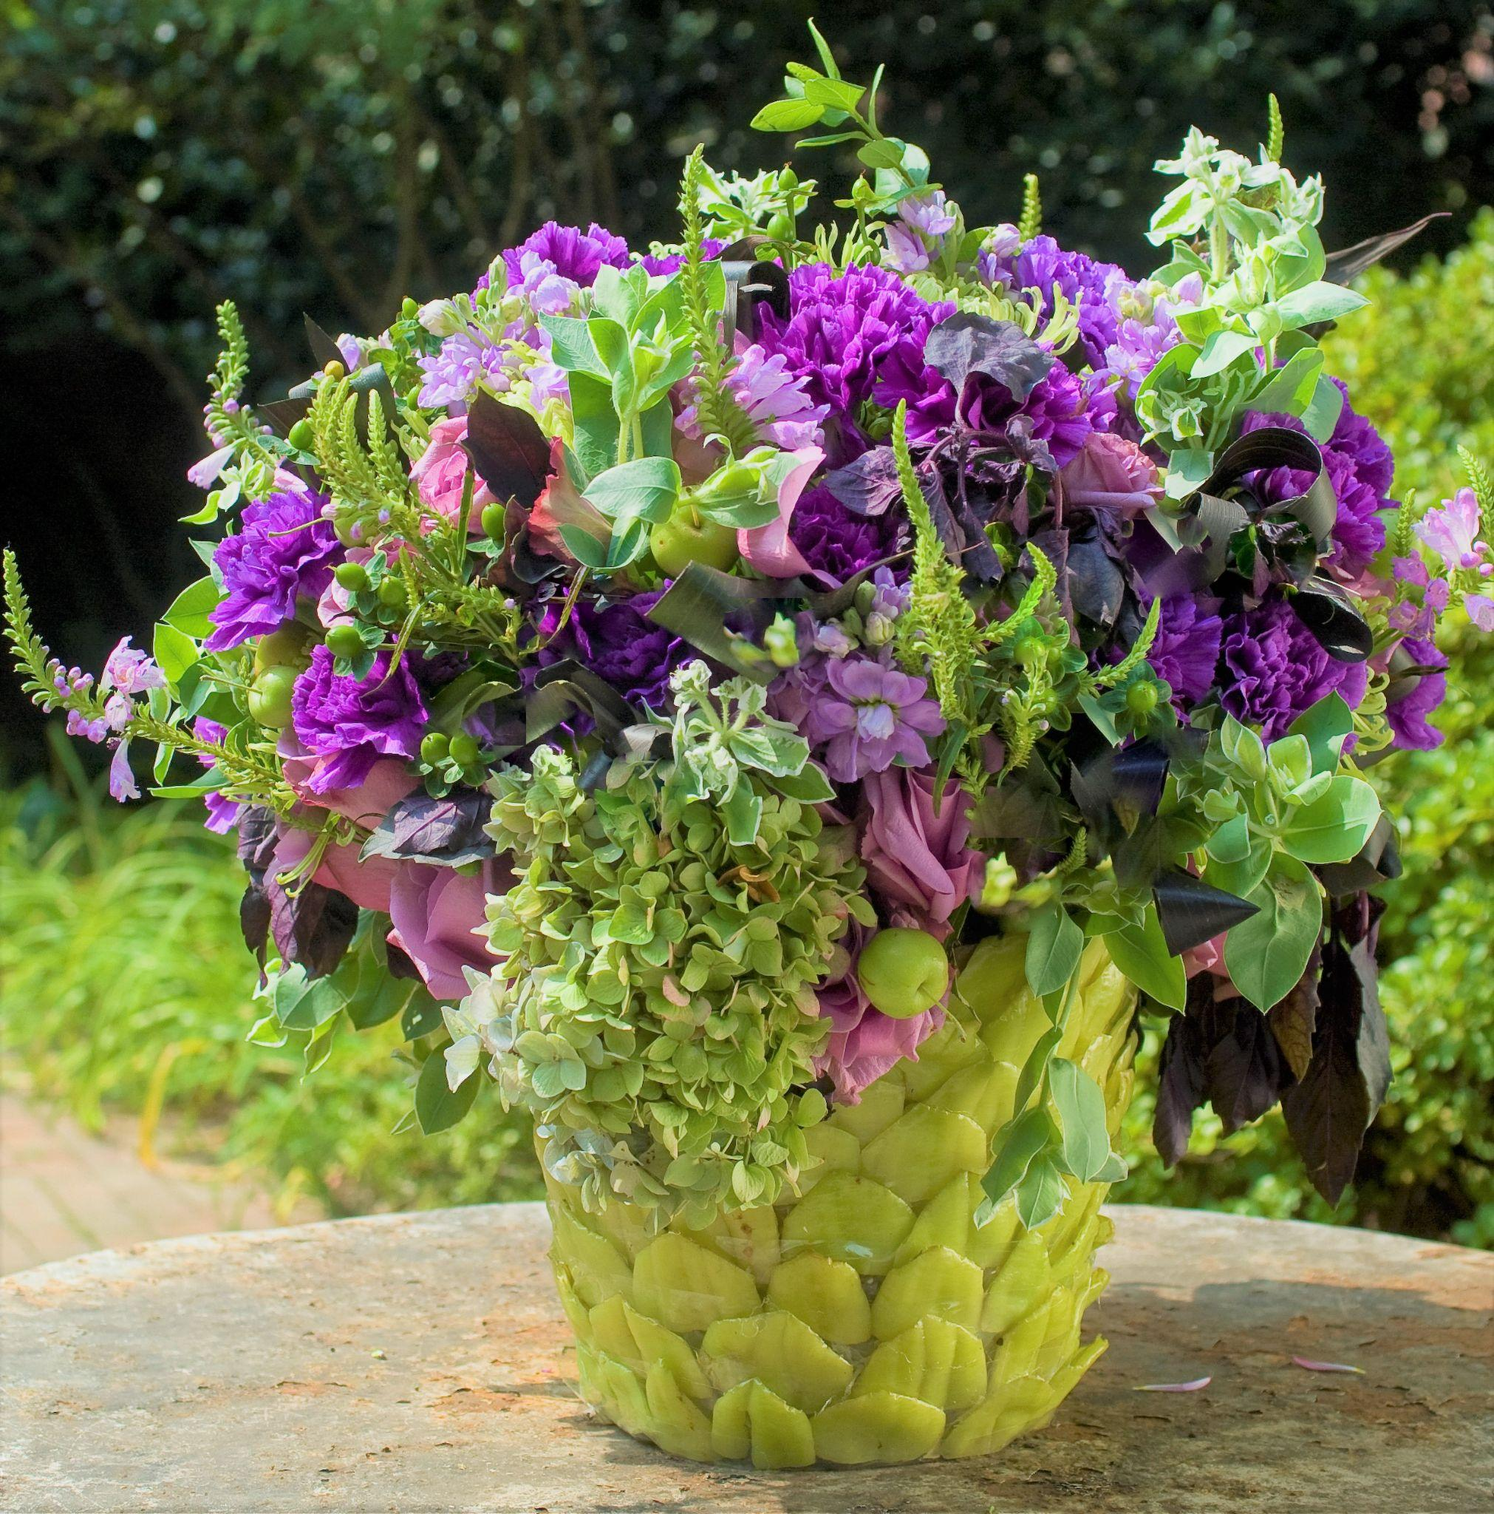

Slide 23
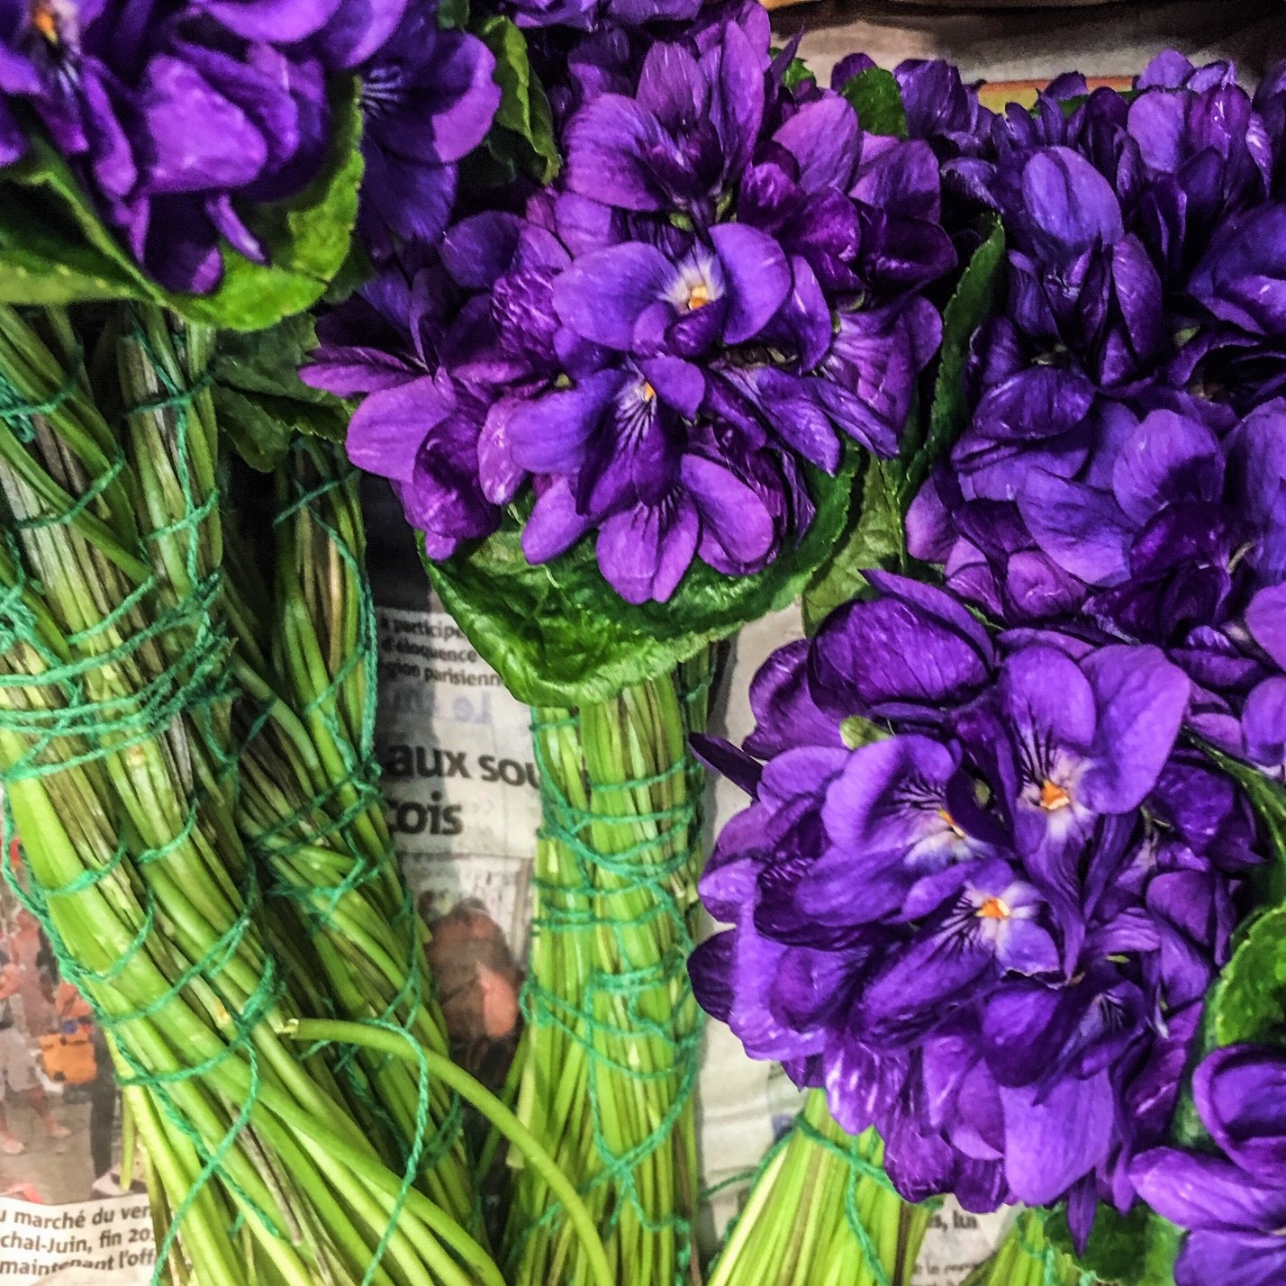

Slide 24
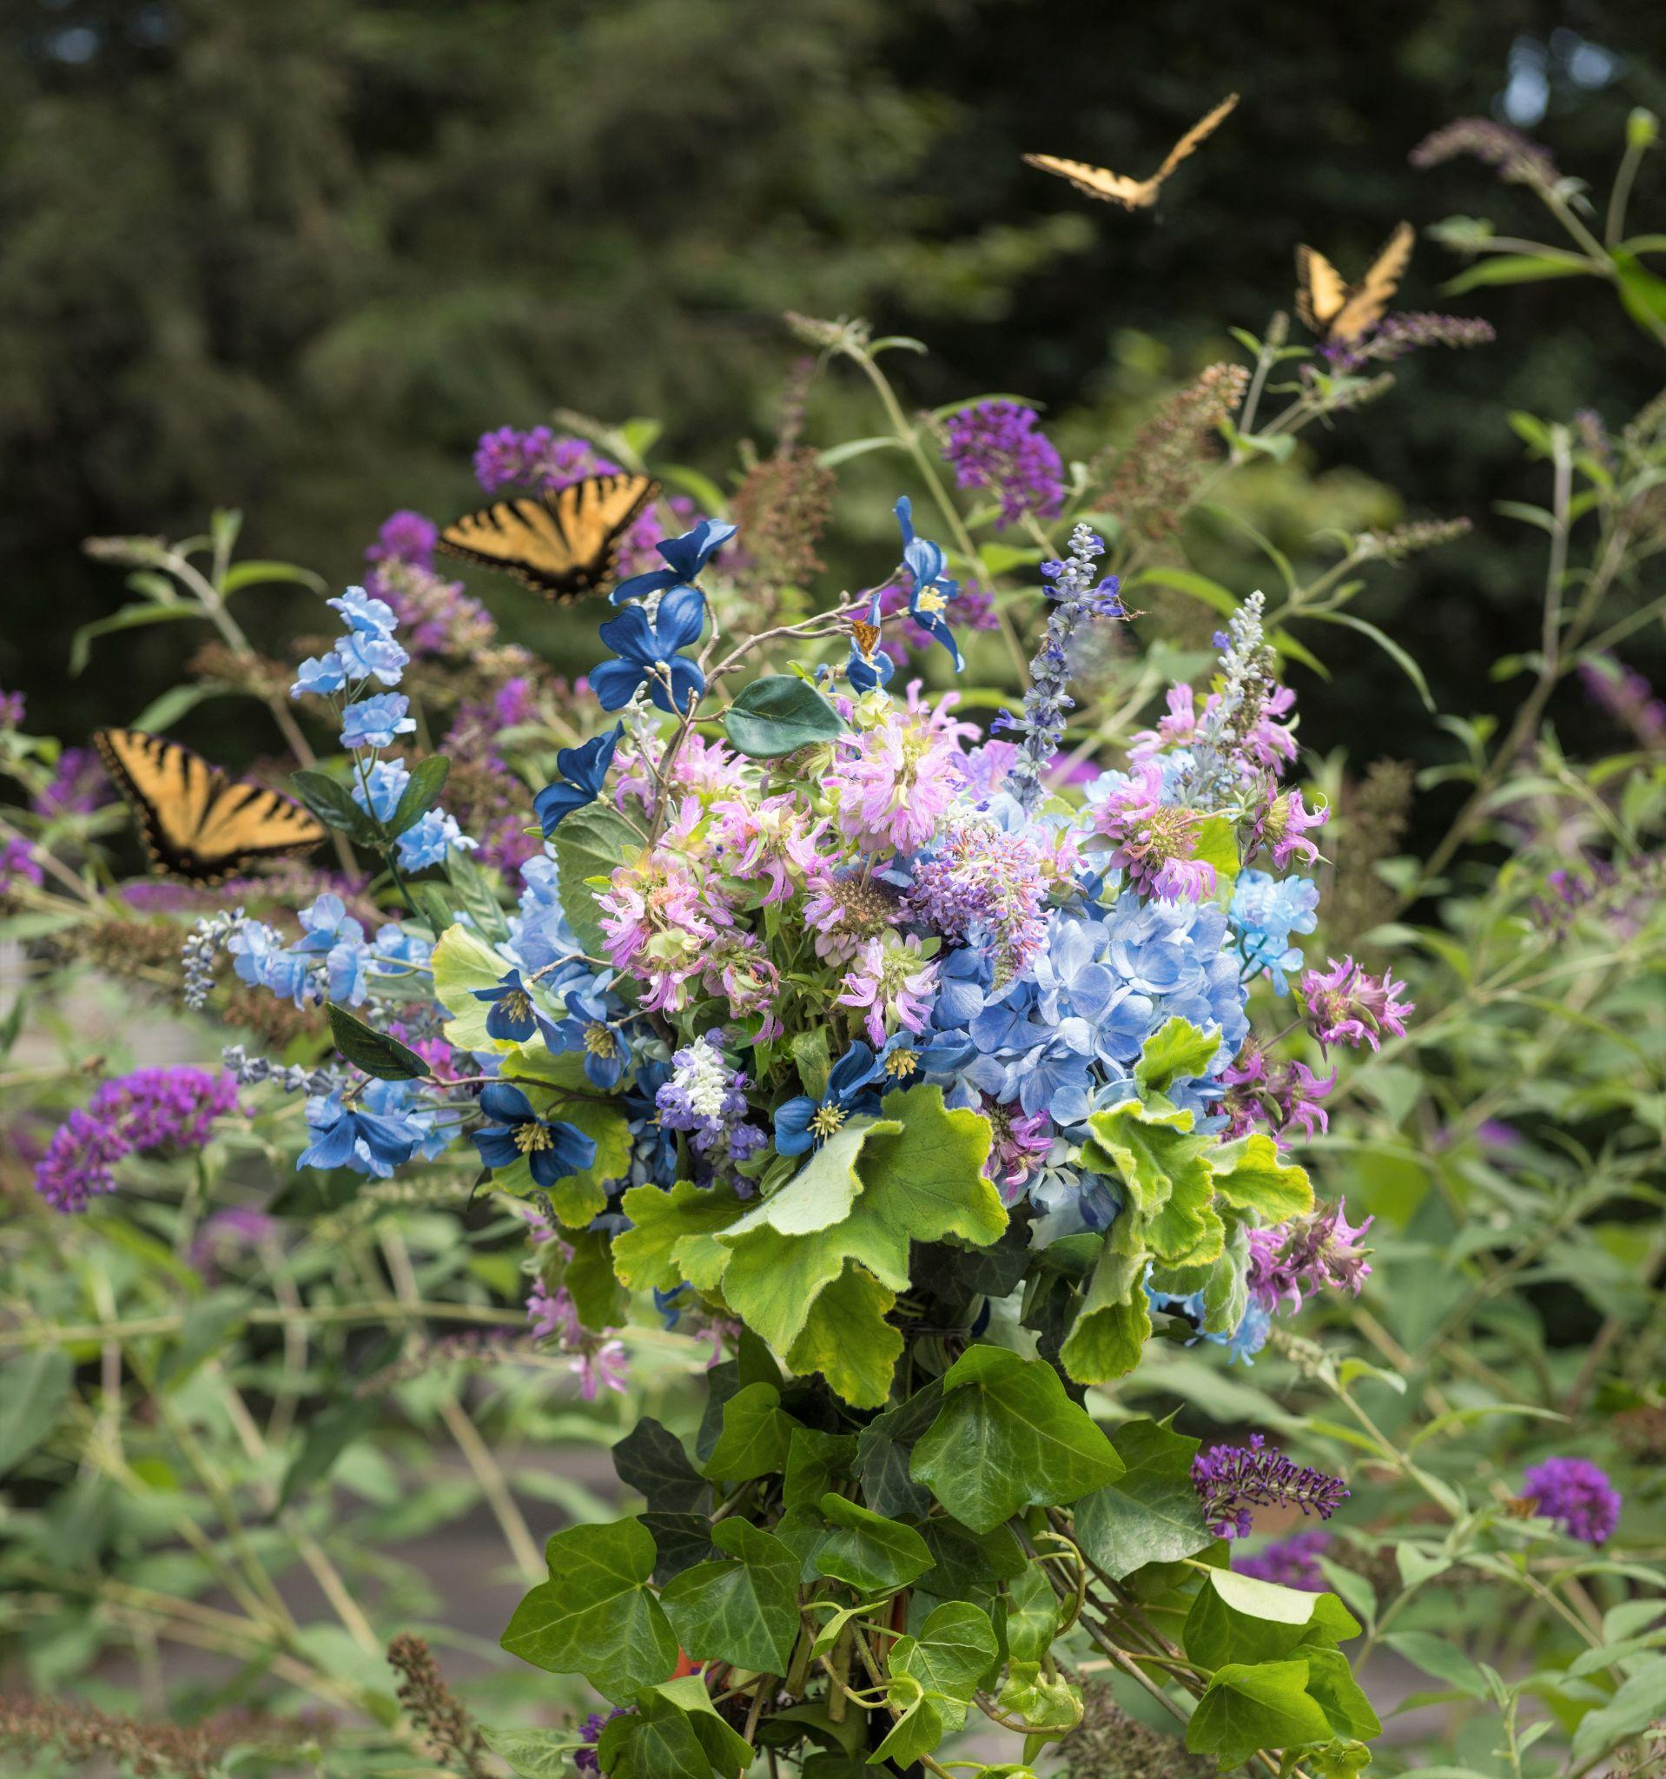
Technique:The Garden Style

Slide 25
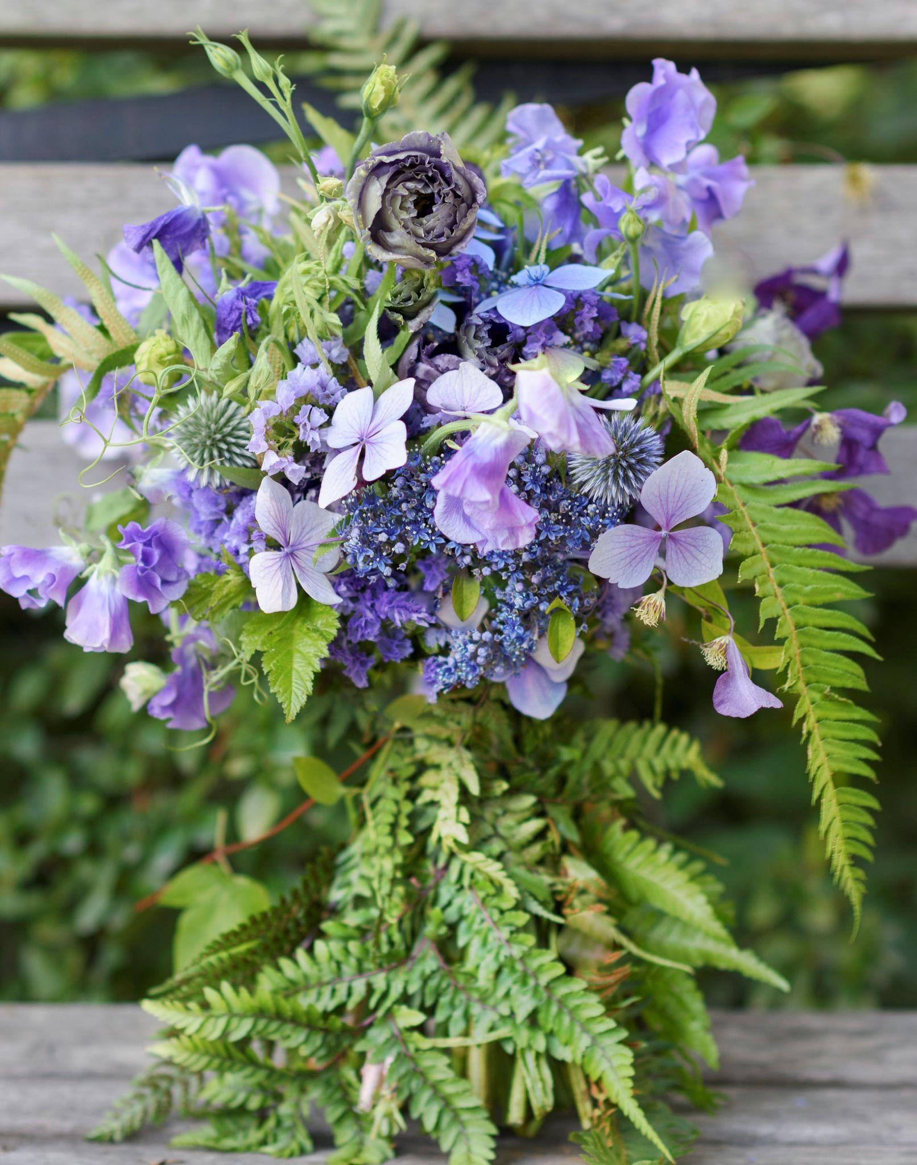
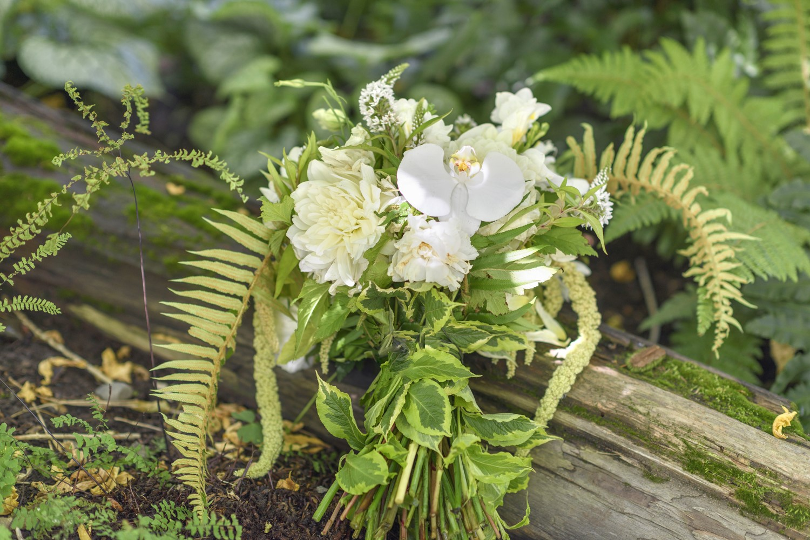
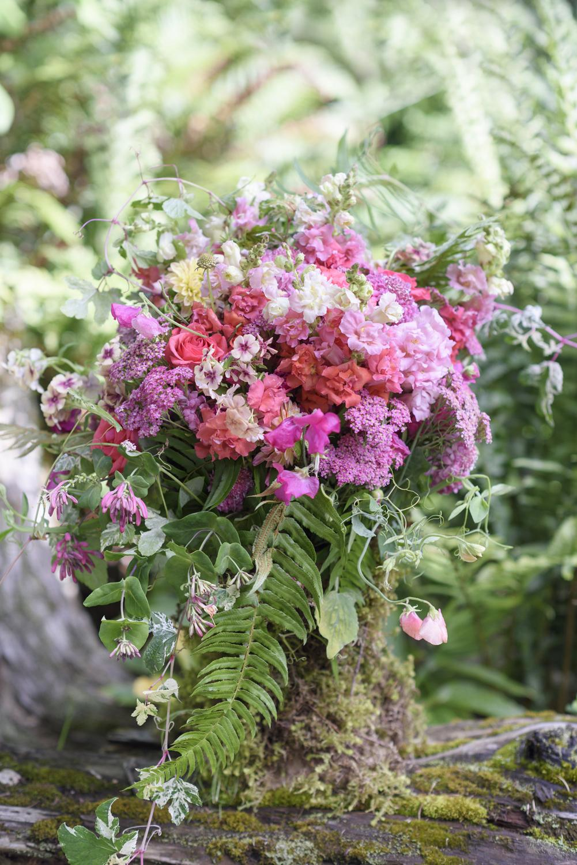

Slide 26
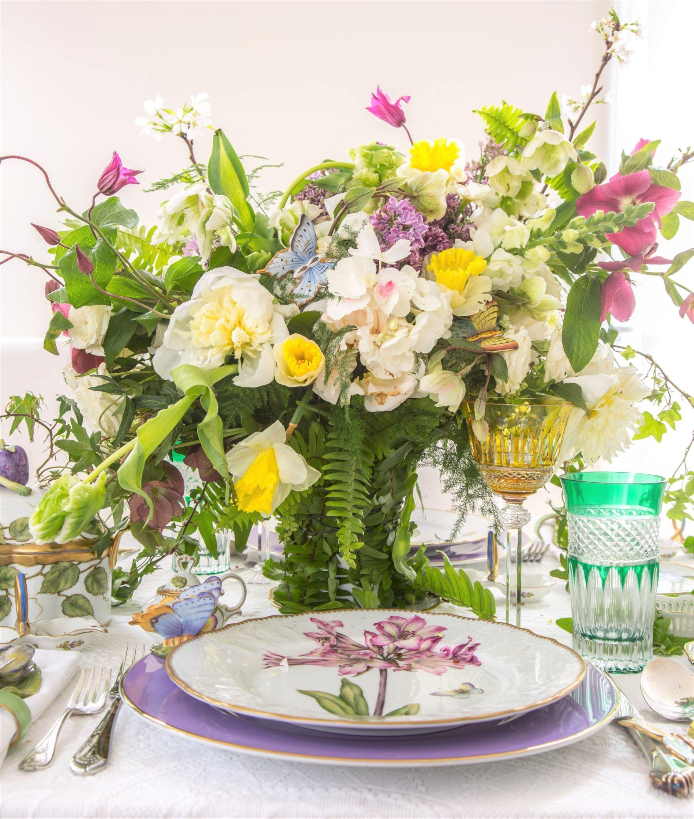
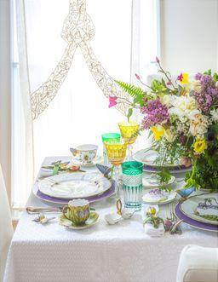
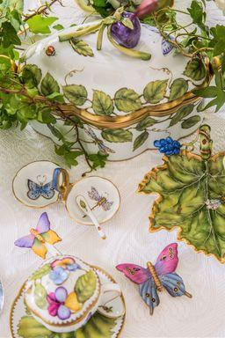

Slide 27

A Northwest Aesthetic

Slide 28
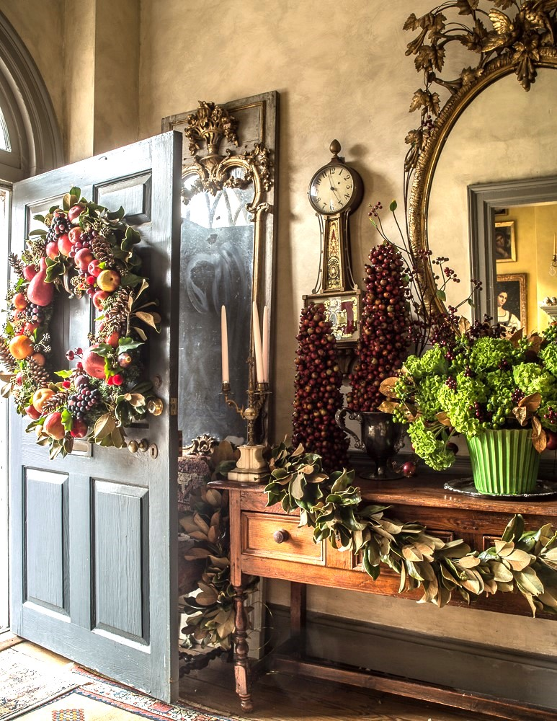
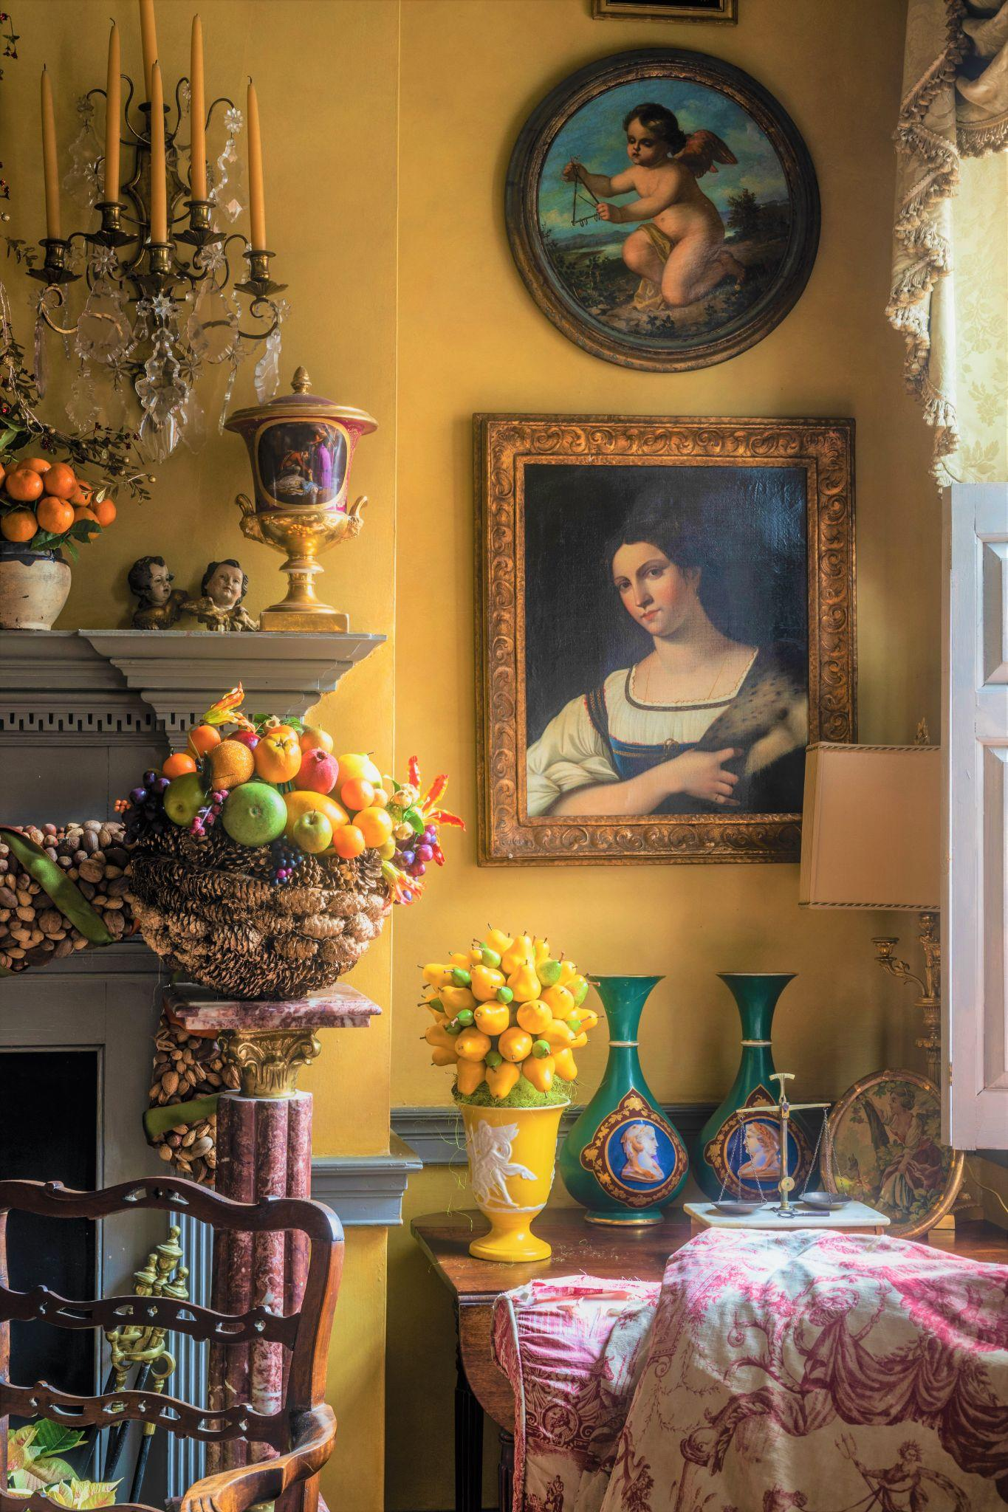
Interiors and Flowers

Slide 29
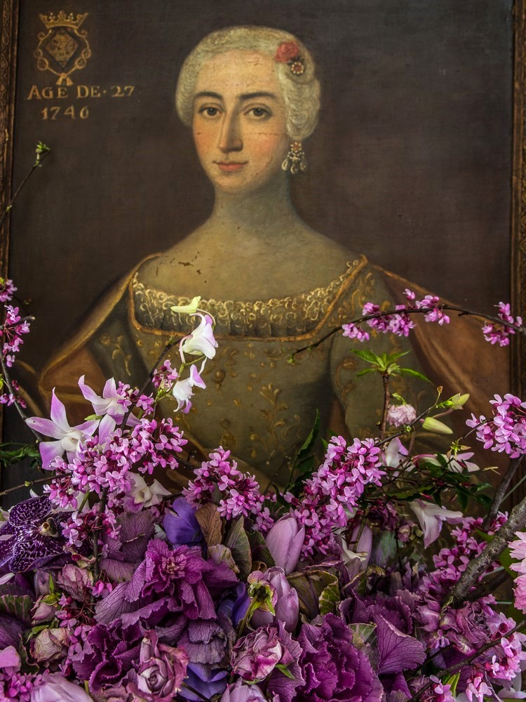
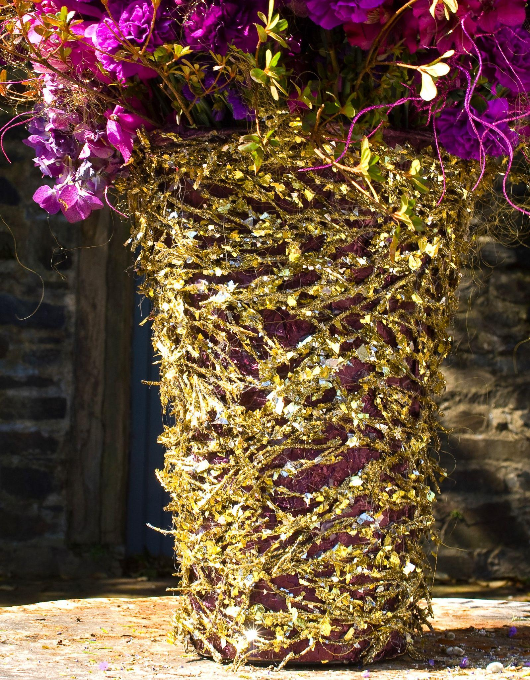

Slide 30
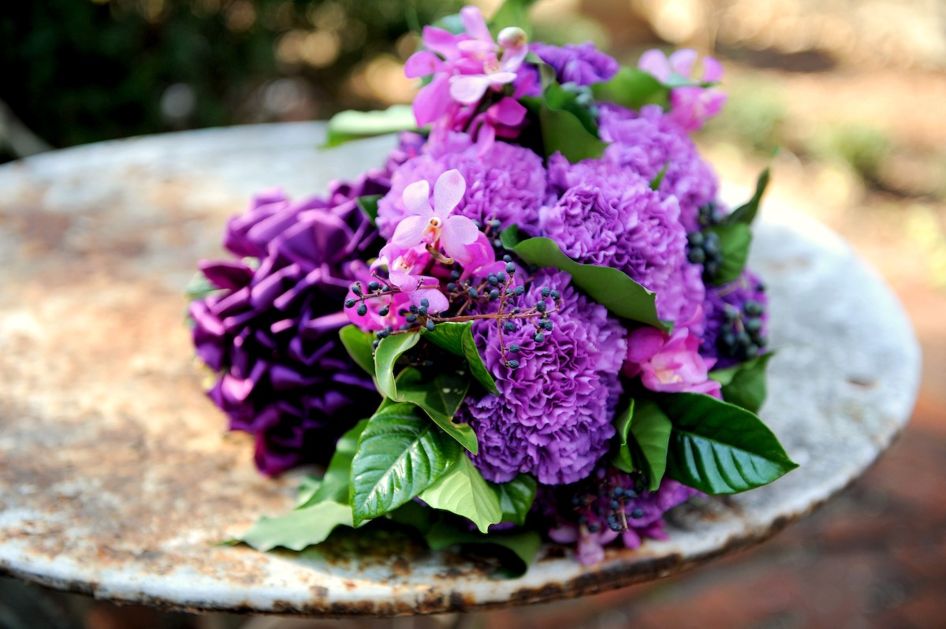

Slide 31
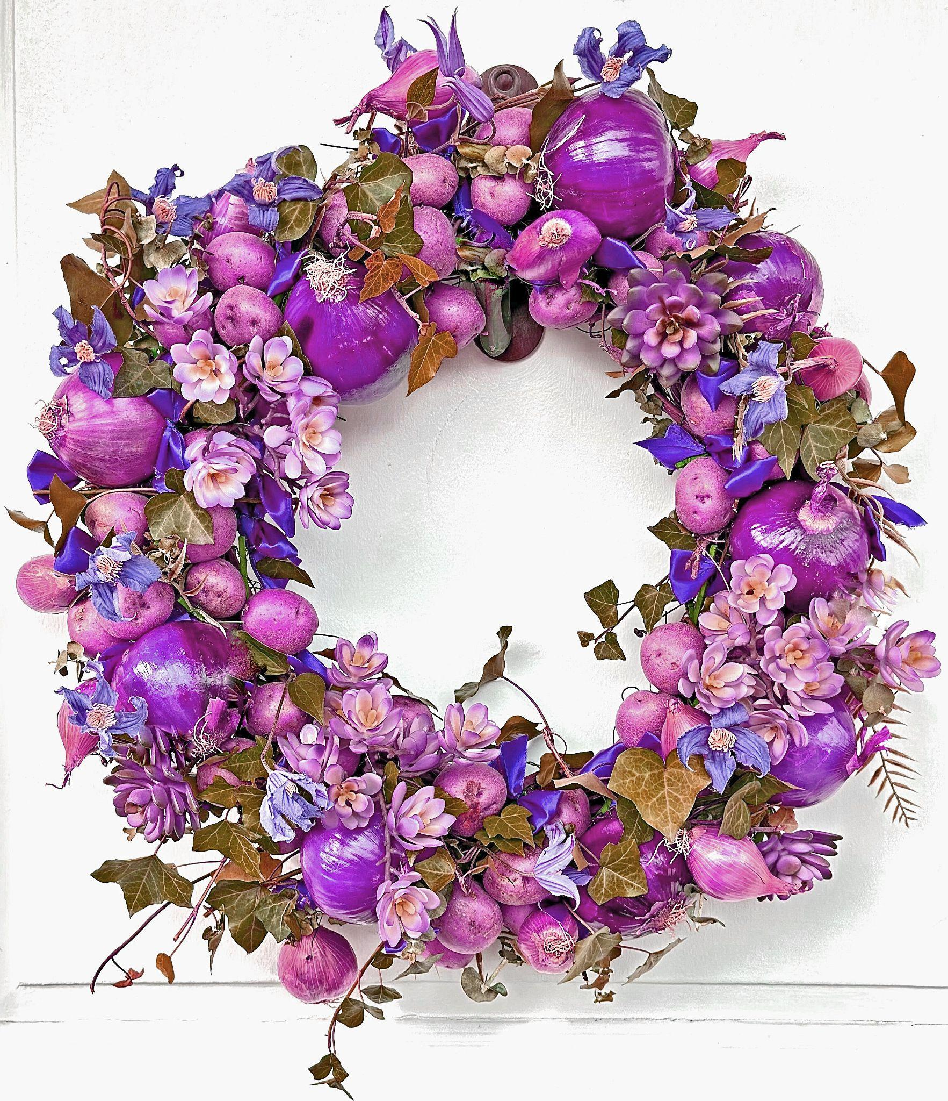
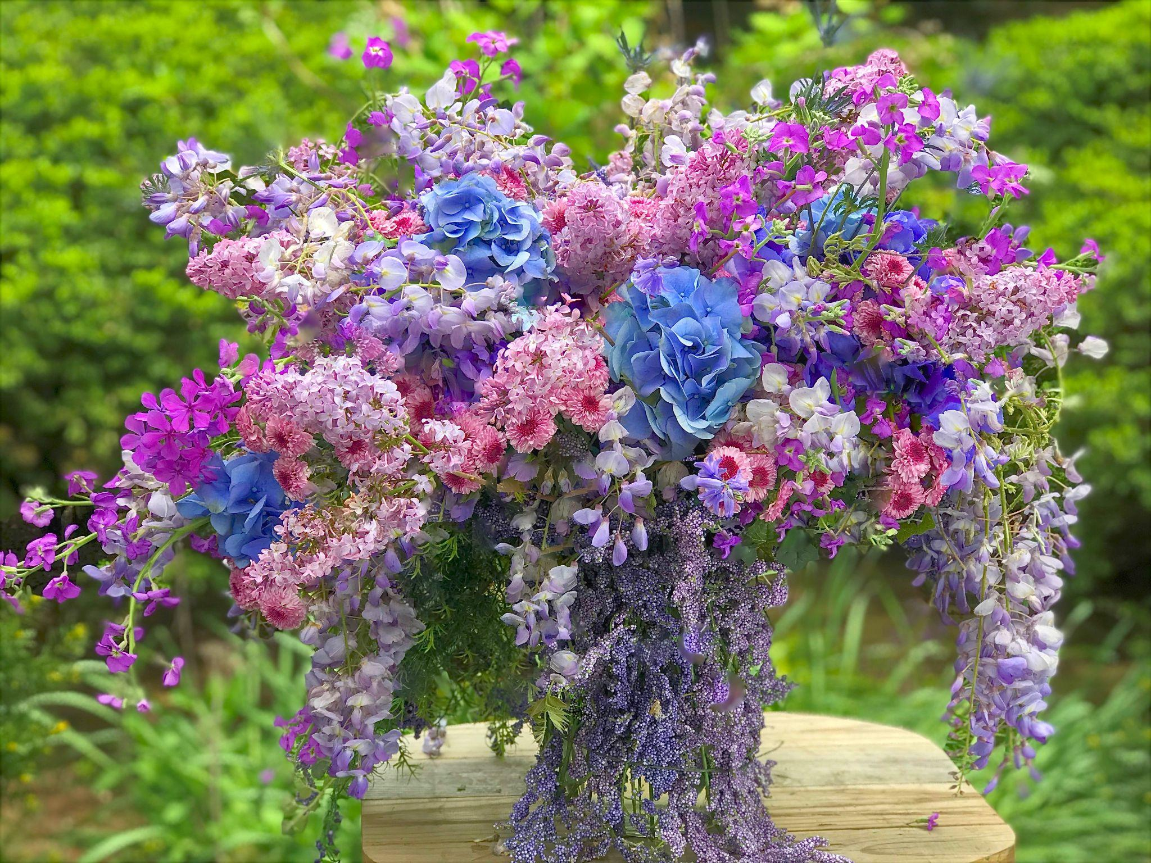

Slide 32
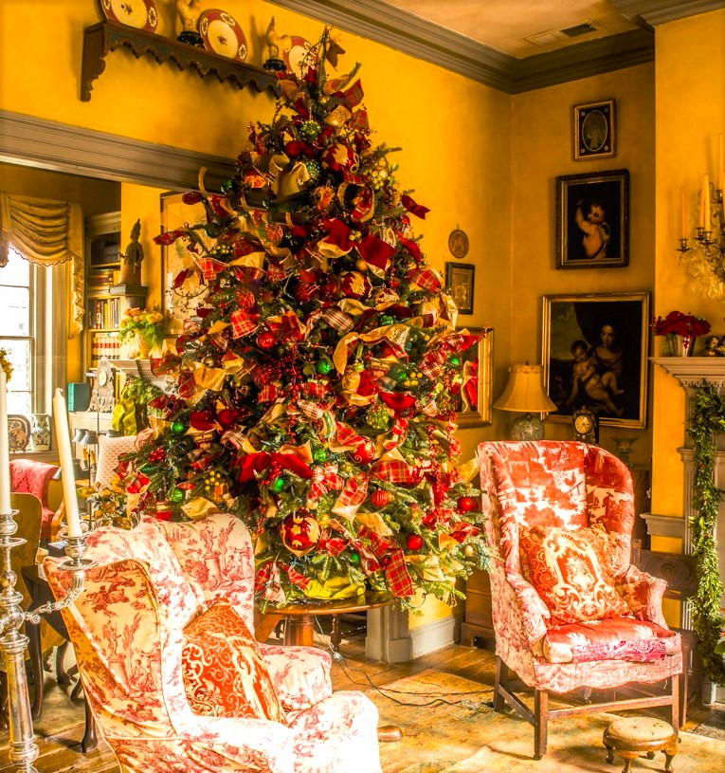
Home for the Holidays

Slide 33
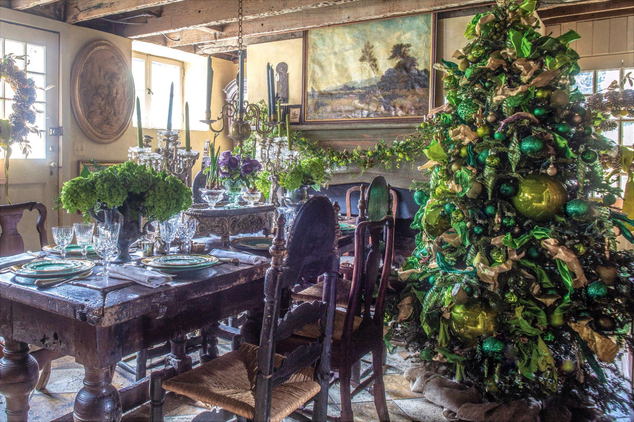

Slide 34
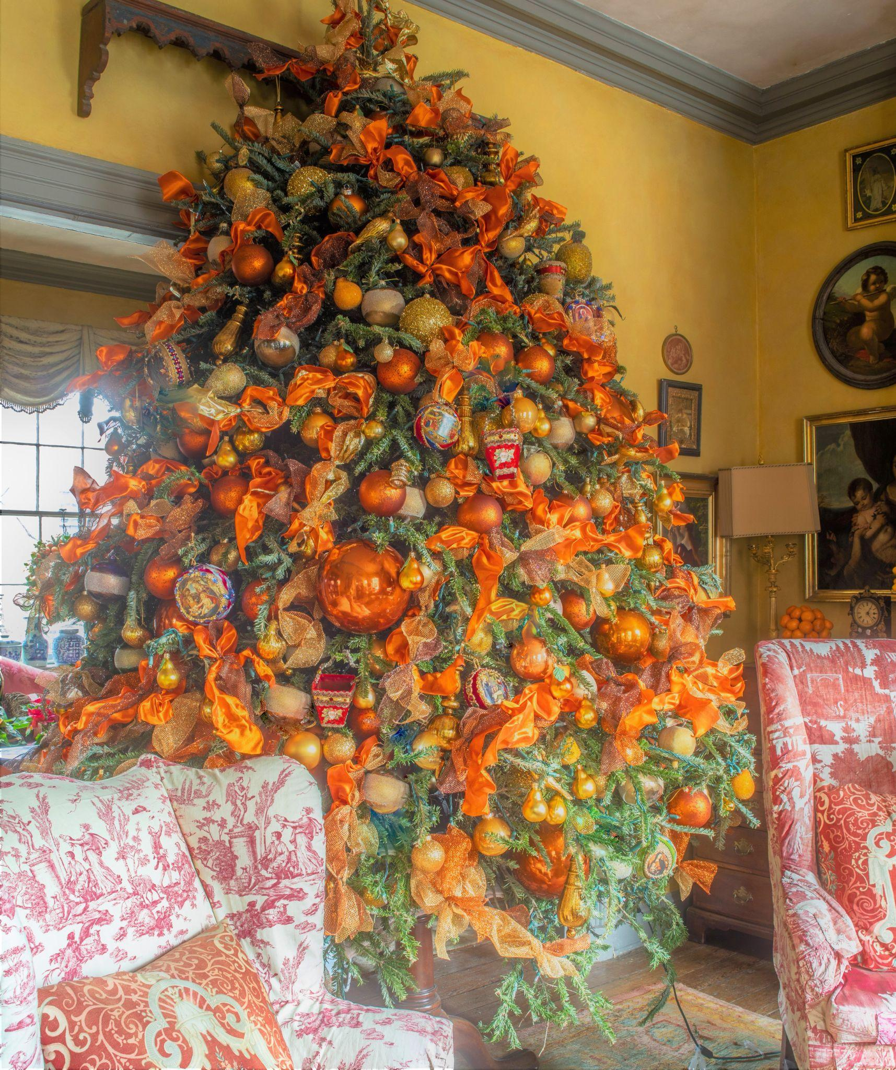
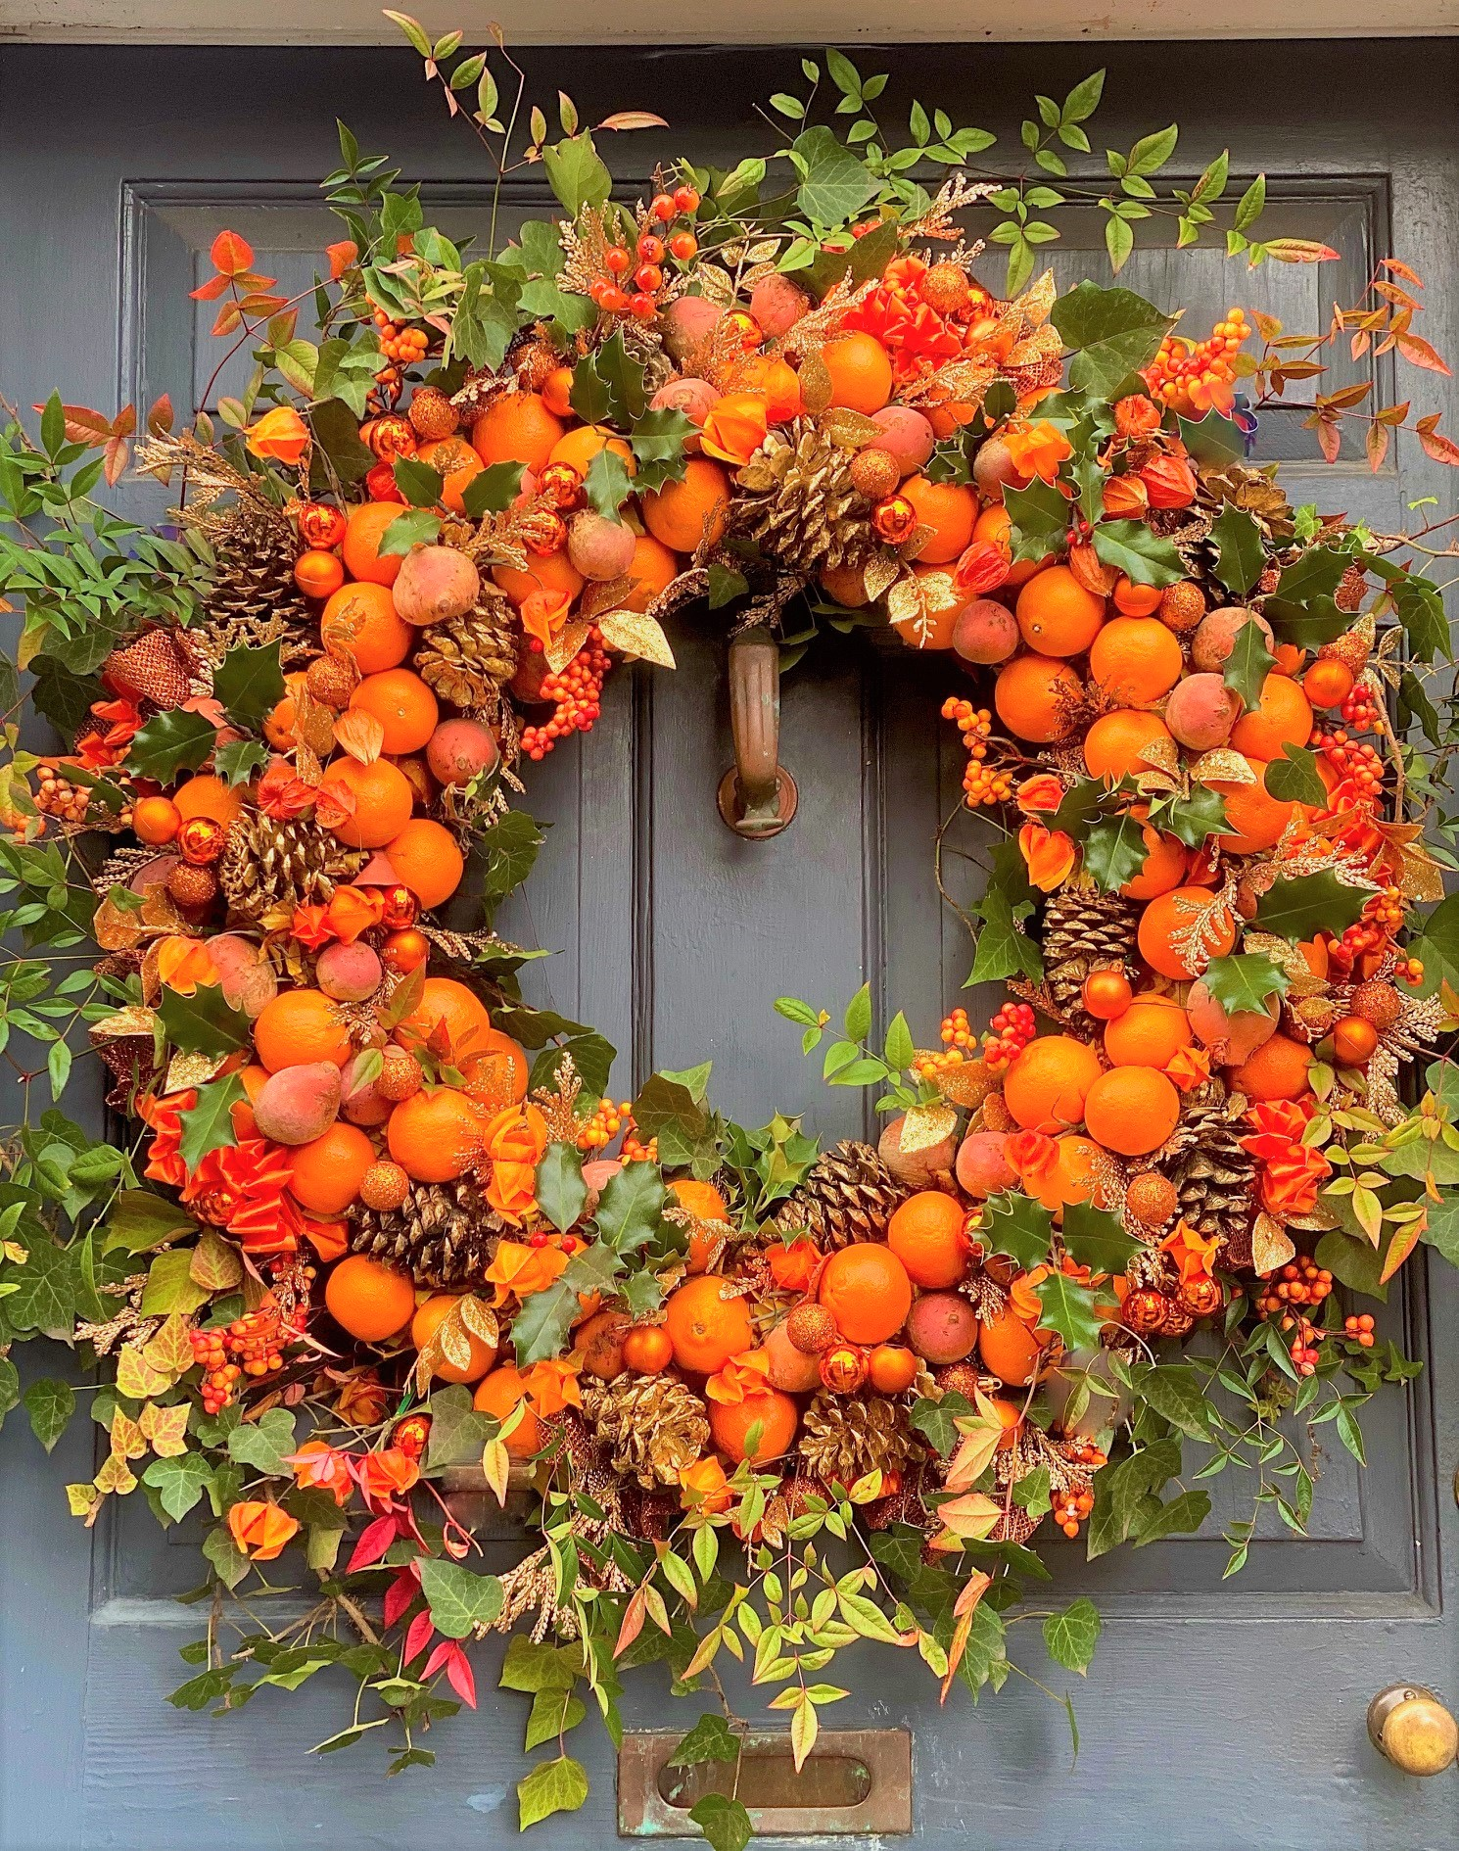



Slide 35



Slide 36


Paris Fleurs

Slide 37


Slide 38



Slide 39


Slide 40



Slide 41



Slide 42




Slide 43



Hotel de Crillon

Slide 44



Slide 45



Slide 46


Slide 47


Slide 48


Slide 49


Slide 50

White House Style

Slide 51

My First State Dinne: India

Slide 52


Slide 53


Slide 54


Slide 55

K

Slide 56


Slide 57


Behind the scenes: The White House Christmas

Slide 58


Slide 59


Slide 60



Slide 61




Slide 62



Slide 63




Slide 64


Slide 65


Slide 66

Signature Elements

Slide 67


Slide 68



Slide 69




Slide 70



Slide 71

Favorite Projects

Slide 72


Slide 74


Slide 75


2019 USPS Holiday Wreaths Forever Stamps

Slide 76


Slide 77

Floral diplomacy: flowers as a strategic tool

Slide 78


Slide 79



Slide 80



Slide 81



Slide 82


Slide 83


Slide 84


Slide 85


Slide 86


Slide 87


Slide 88


Slide 89



Slide 90


Cheekwood

Slide 91



Slide 92



Slide 93



Slide 94



Slide 95


Slide 96



Slide 97



Slide 98


Slide 99




Slide 100


Slide 101




Slide 102


Slide 103


Slide 104



Slide 105



Slide 106

L’Art du Bouquet

